Slide 1
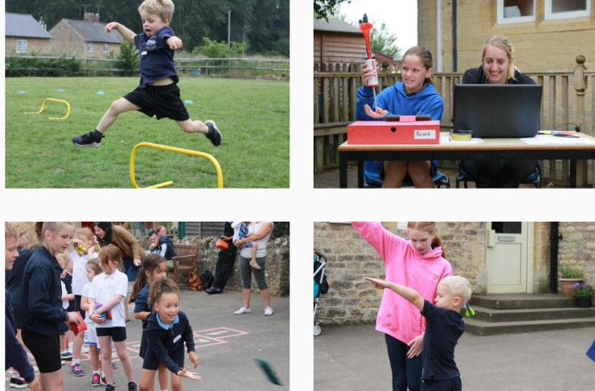

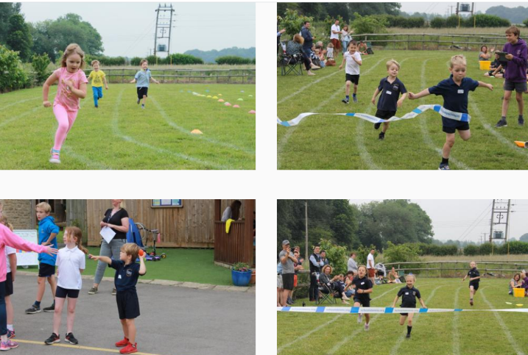
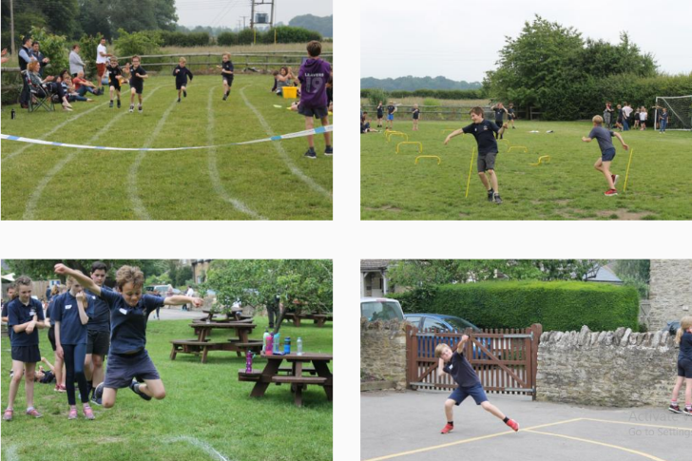
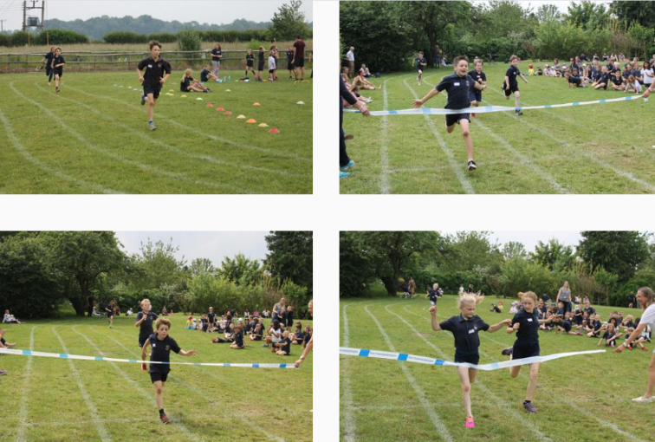
Today should have been Sports day at school so we are going to have a sports day at home!

Slide 2




Remember
Wear your PE kit
Drink plenty of water
Have some healthy snacks e.g. oranges to keep your energy up
Wear sun cream if it is hot and sunny
Try your best
Have fun!!!

Slide 3
On this PowerPoint, there are a number of sporting activities which you can do at home.
We have included some competitions and the certificates if you would like them! ☺

Slide 4
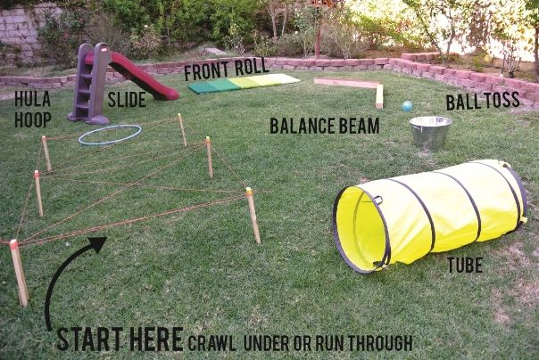
Activity 1:
Create an obstacle course in the garden with your family.
Take it in turns to have a go and time each other

Slide 5

Activity 2:
Choose your favourite family song and create a dance routine to it.

Slide 6

Activity 3: Recreate sports day
Long jump: set up a tape measure and see who can jump the furthest. Can you beat your own score?
Long distance running: Try running 3 laps around your garden. How long does it take?
Short distance running: Run 1 lap of your garden as quickly as you can.
Throwing: Set up a tape and see how far you can throw a ball.

Slide 7
Activity 4:
Throwing and catching
How many throws and catches can you do with a partner?
Throw a ball up in the air, how many claps can you do before catching it?

Slide 8
Activity 5:
Racket volley challenge:
How many volleys can you do with a partner with a bat and ball?

Slide 9
Activity 6:
Mini games:
Play a mini game of your favourite sport e.g. football/cricket/netball
Remember to make sure the teams are fair. You get bonus points for good sportsmanship! ☺

Slide 10
Activity 7:
Feeling tired?
Why not have a go at being a sports reporter. Video a family member taking part in an activity and do the commentary.
Write a news report or your favourite activity.

Slide 11


