Slide 1
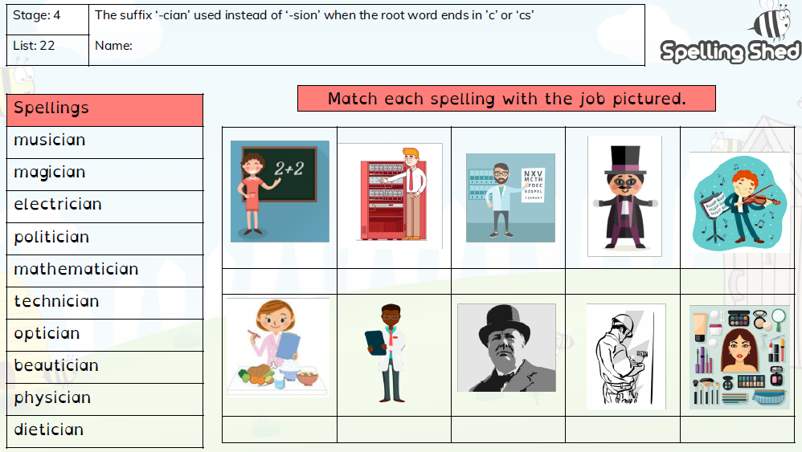
Year 4 Term 6 Week 1

Slide 2
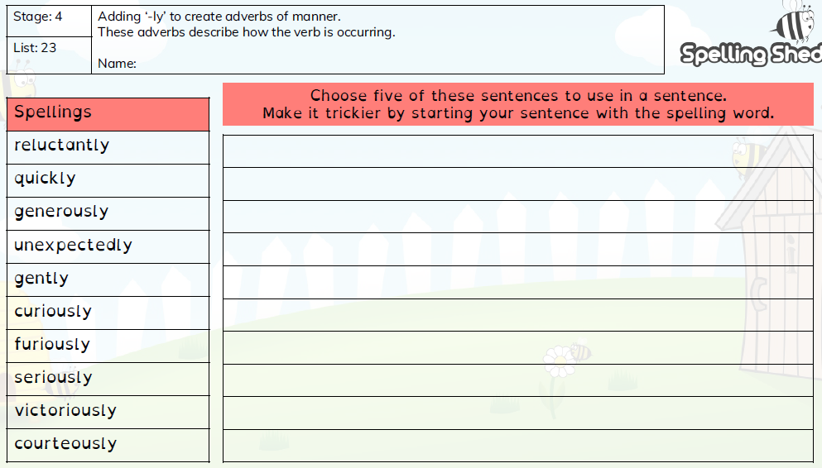
Year 4 Term 6 Week 2

Slide 3
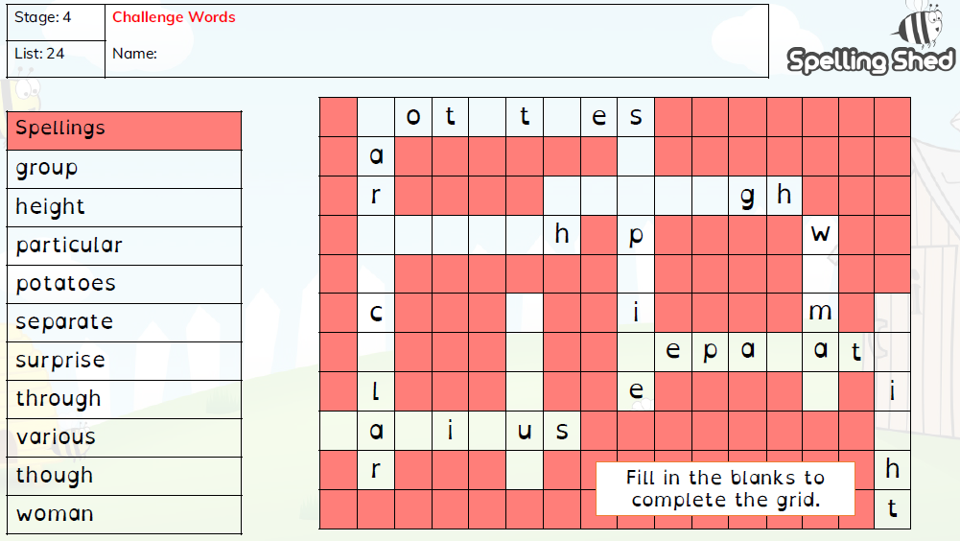
Year 4 Term 6 Week 3

Slide 4
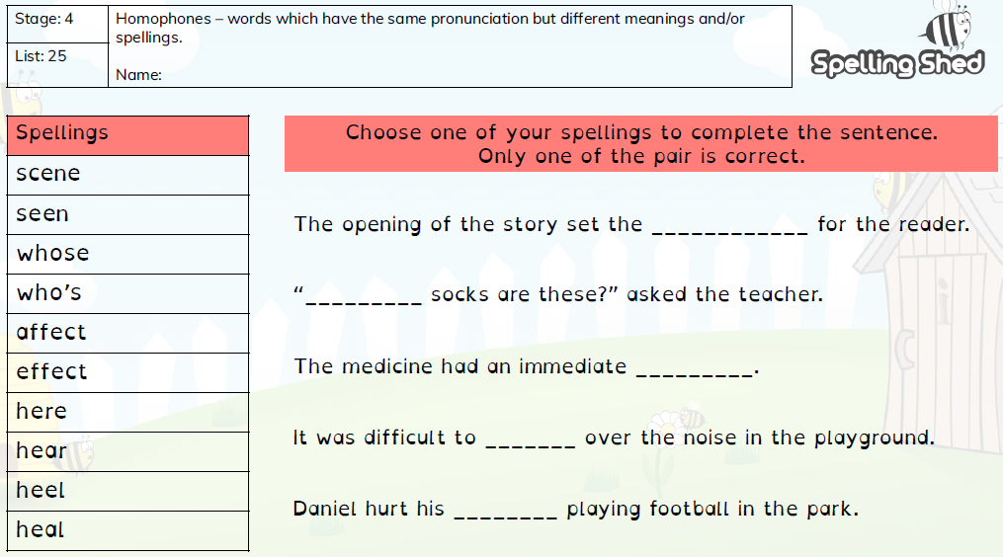
Year 4 Term 6 Week 4

Slide 5
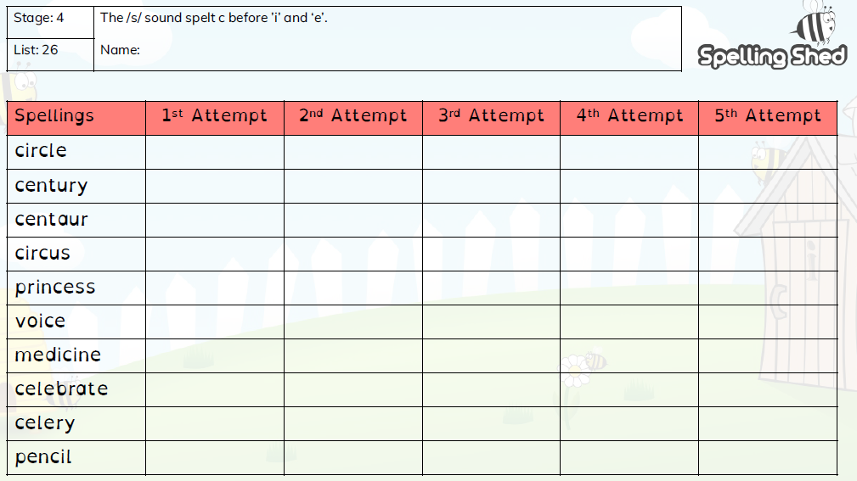
Year 4 Term 6 Week 5

Slide 6
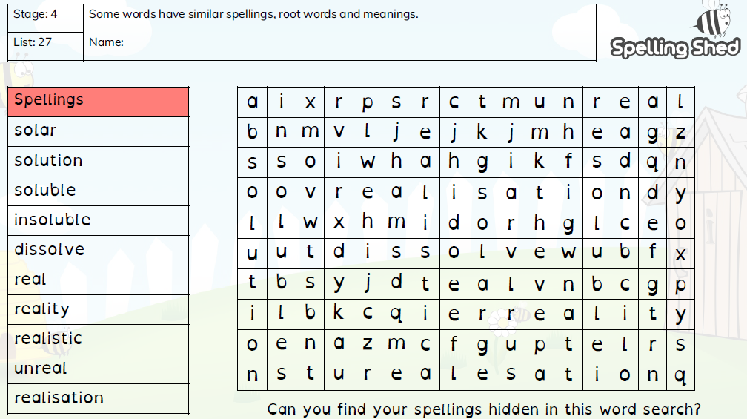
Year 4 Term 6 Week 6

