Slide 1
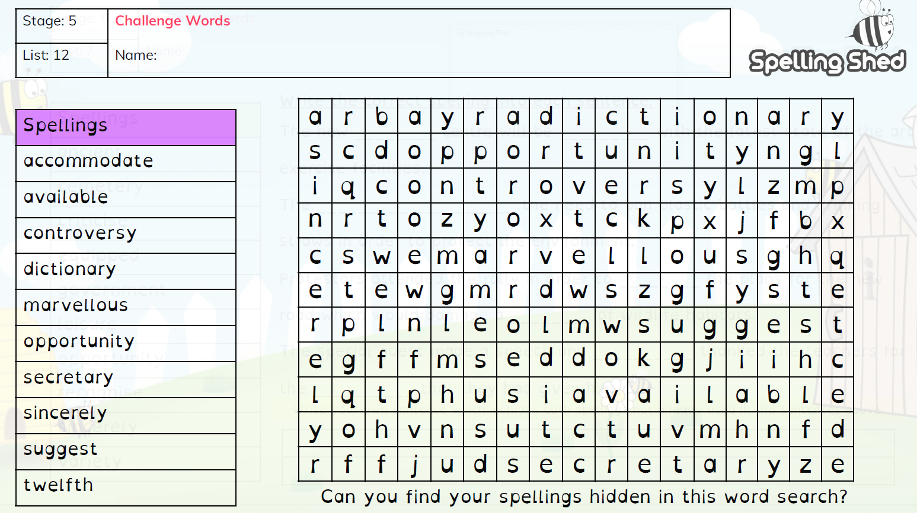
Year 5 Week 1 Term 3

Slide 2
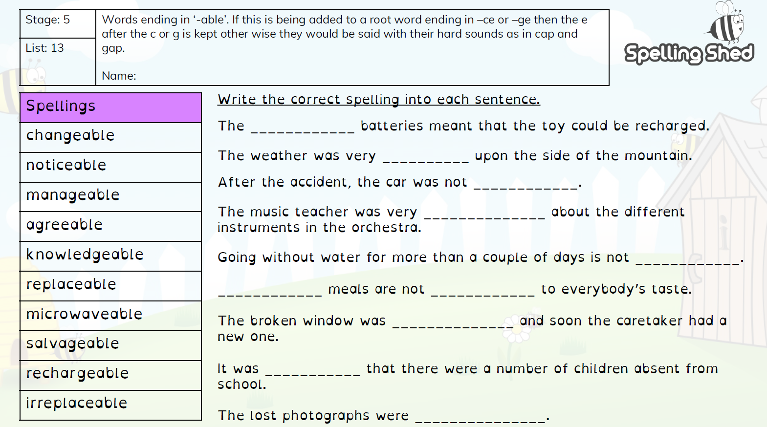
Year 5 Week 2 Term 3

Slide 3
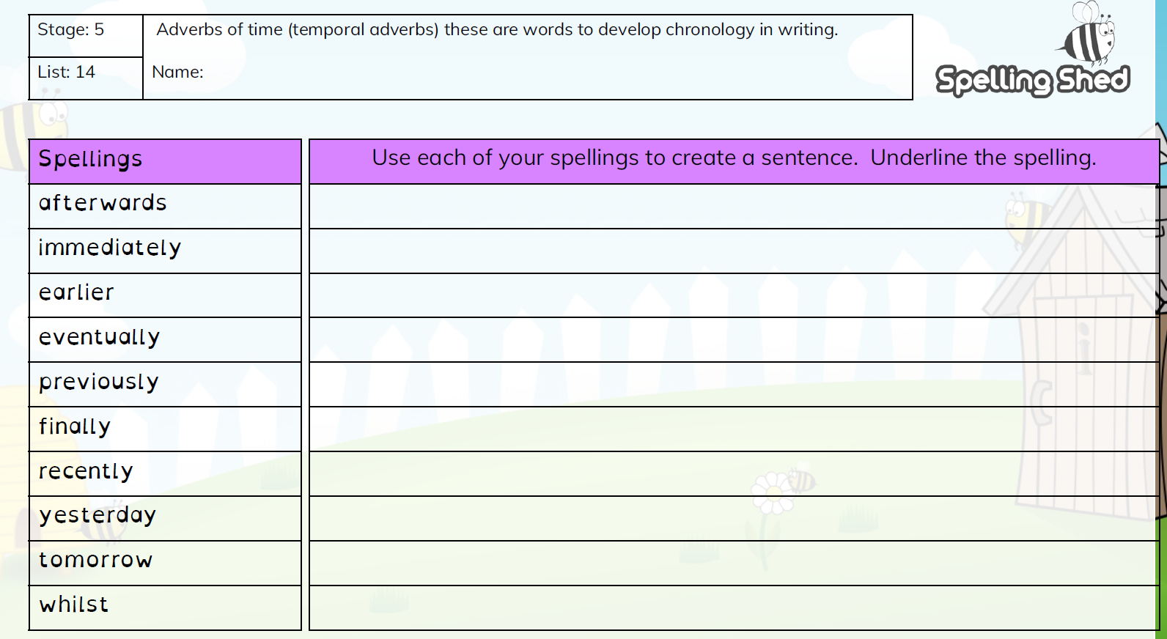
Year 5 Week 3 Term 3

Slide 4
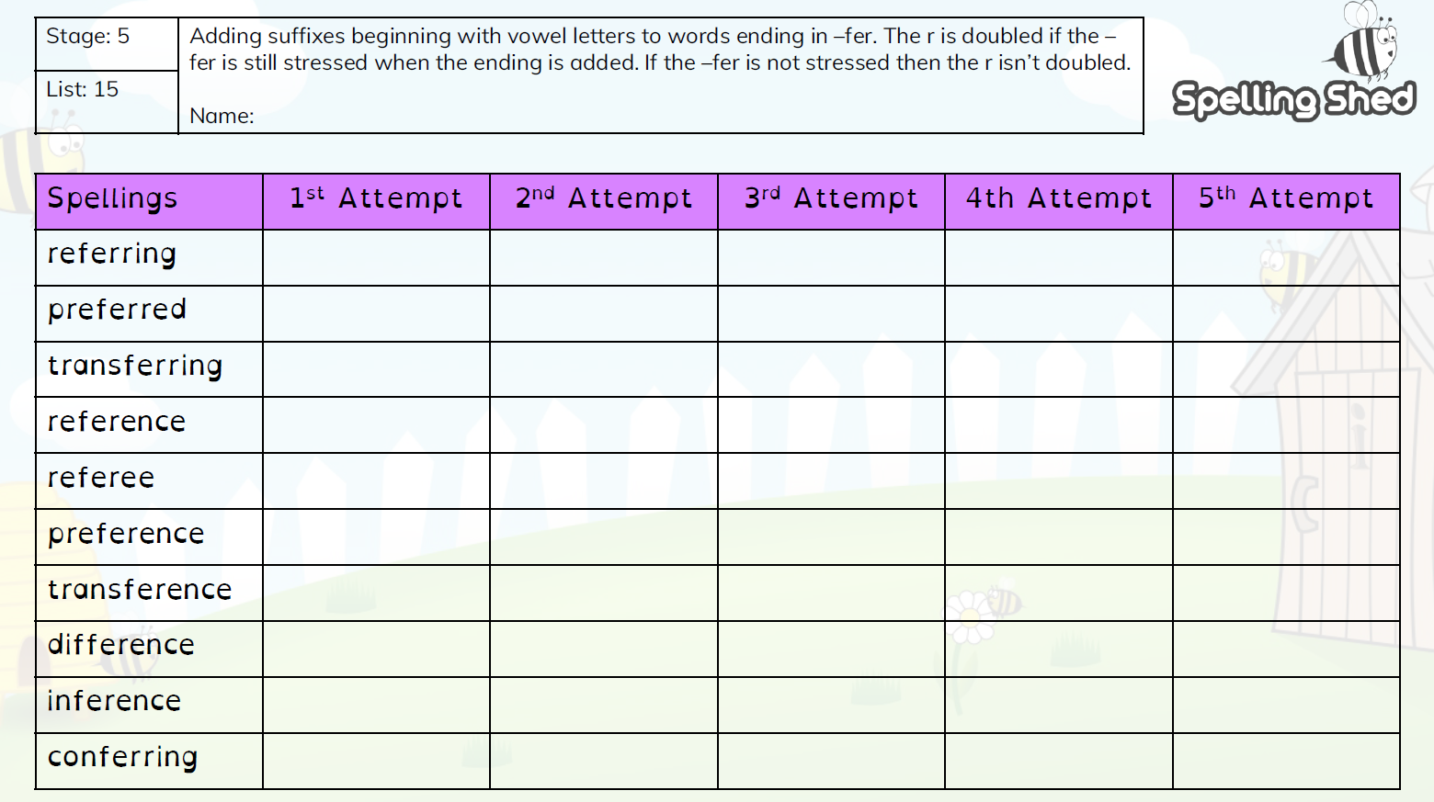
Year 5 Week 4 Term 3

Slide 5
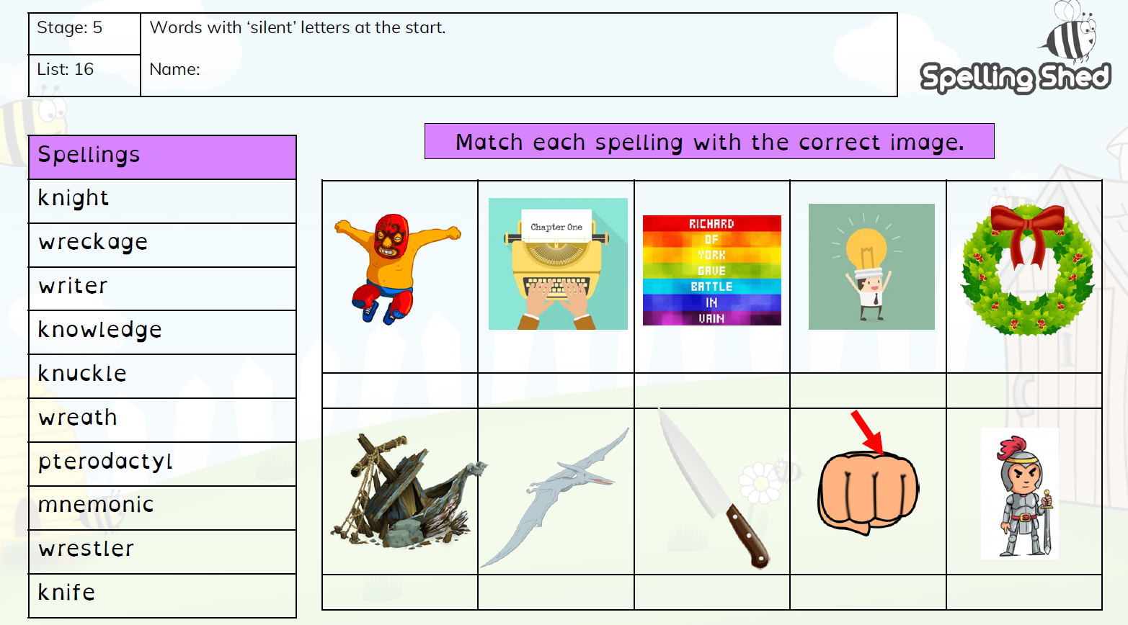
Year 5 Week 5 Term 3

Slide 6
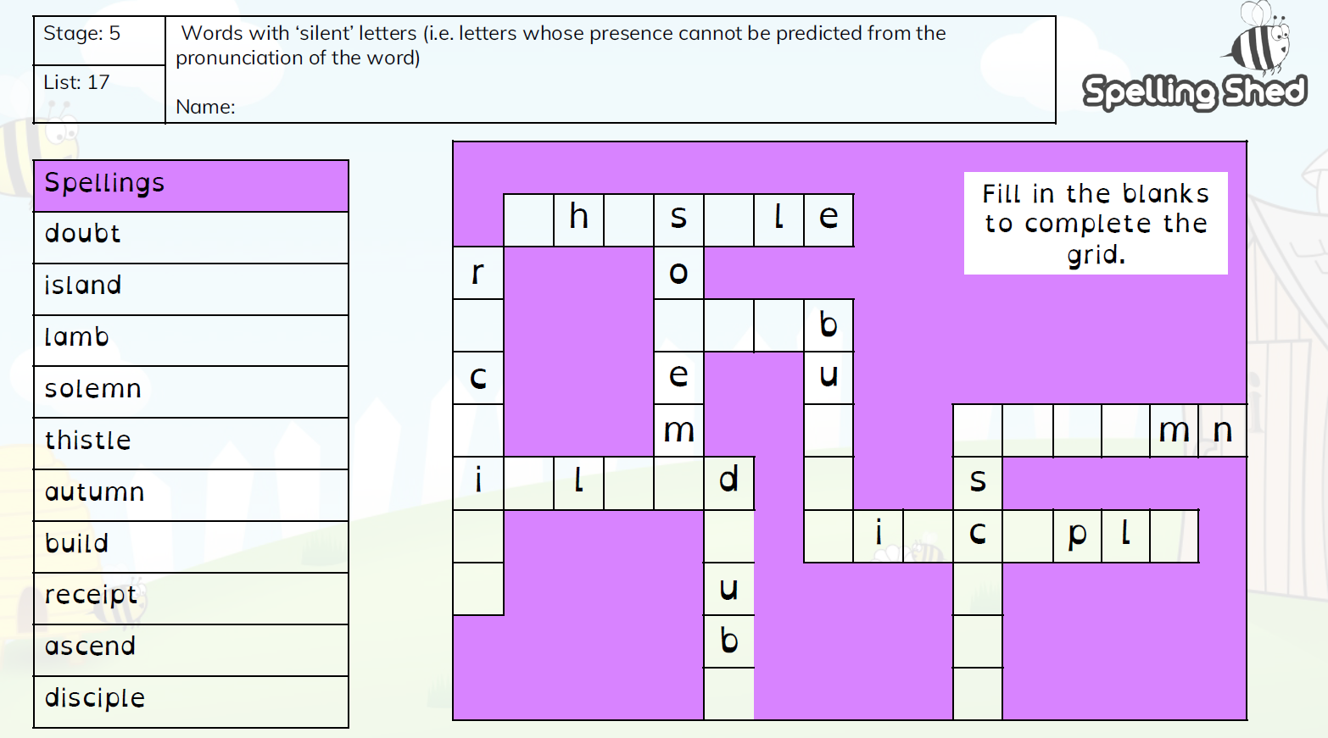
Year 5 Week 6 Term 3

