Slide 1
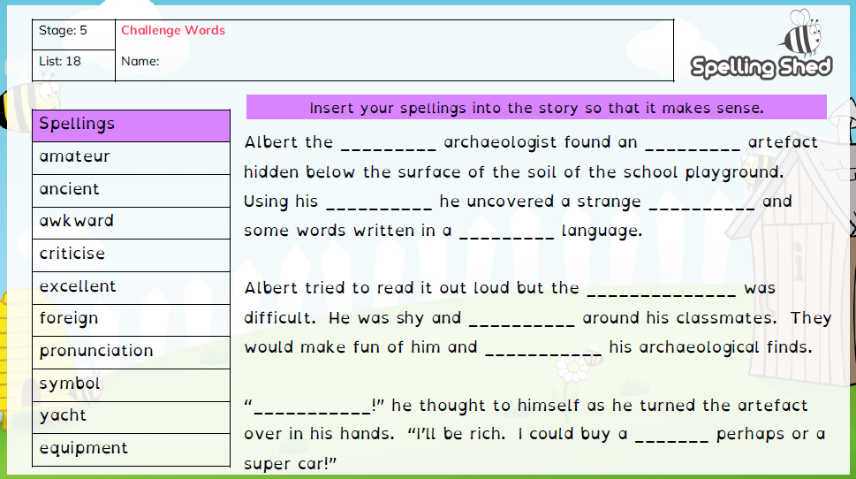
Year 5 Term 4 Week 1

Slide 2
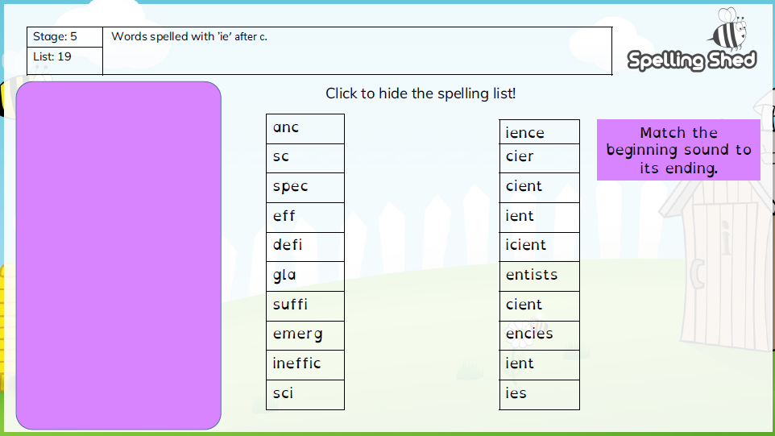
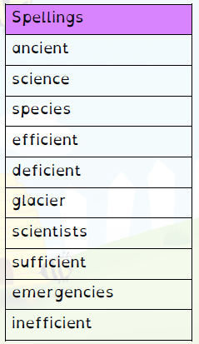
Year 5 Term 4 Week 2

Slide 3
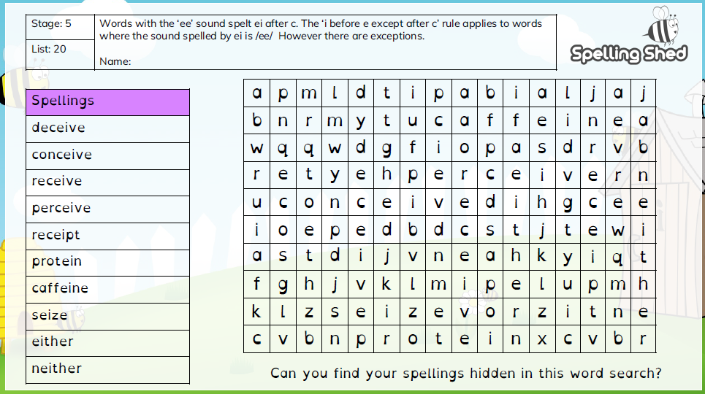
Year 5 Term 4 Week 3

Slide 4
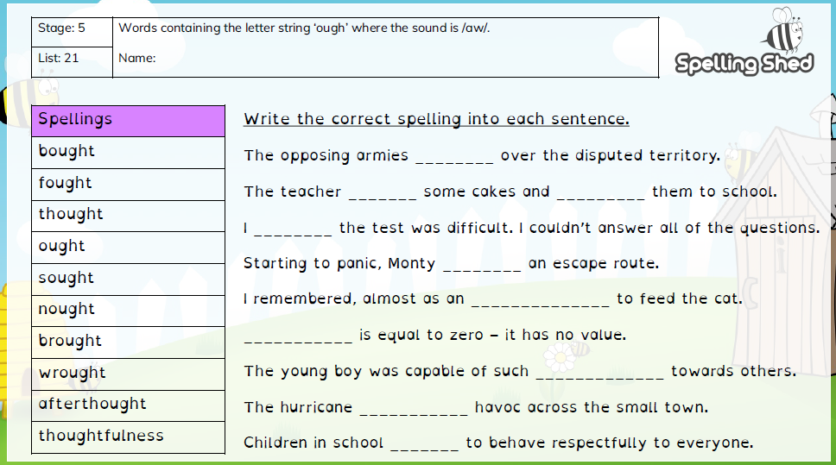
Year 5 Term 4 Week 4

Slide 5
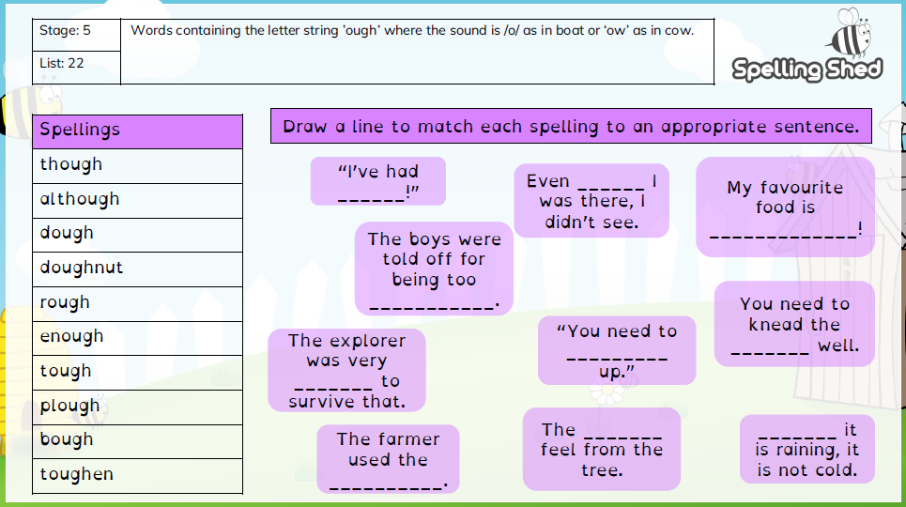
Year 5 Term 4 Week 5

