Slide 1
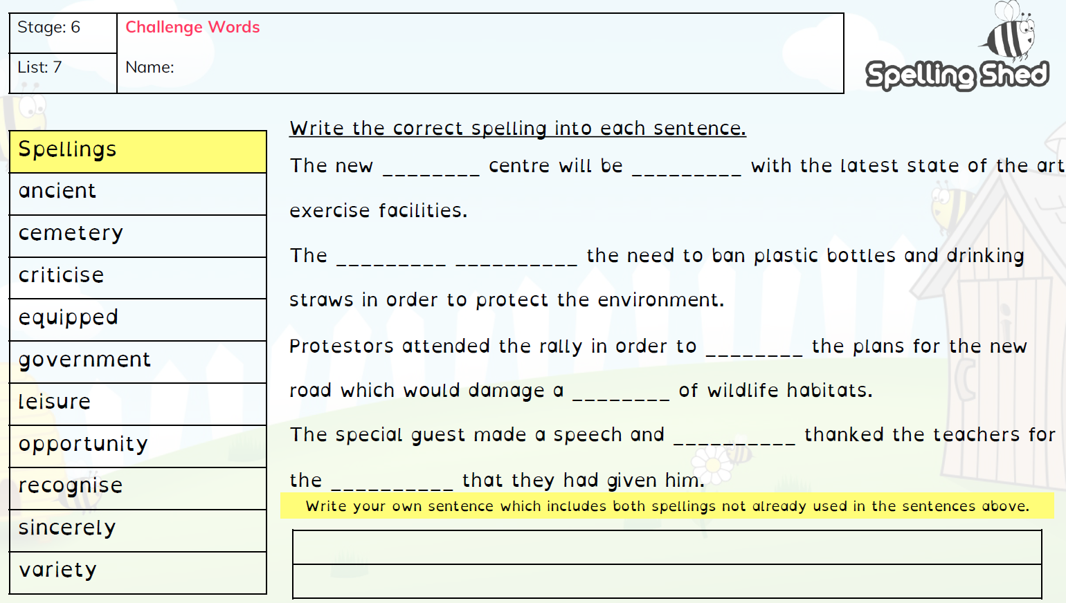
Year 6 Week 1 Term 3

Slide 2
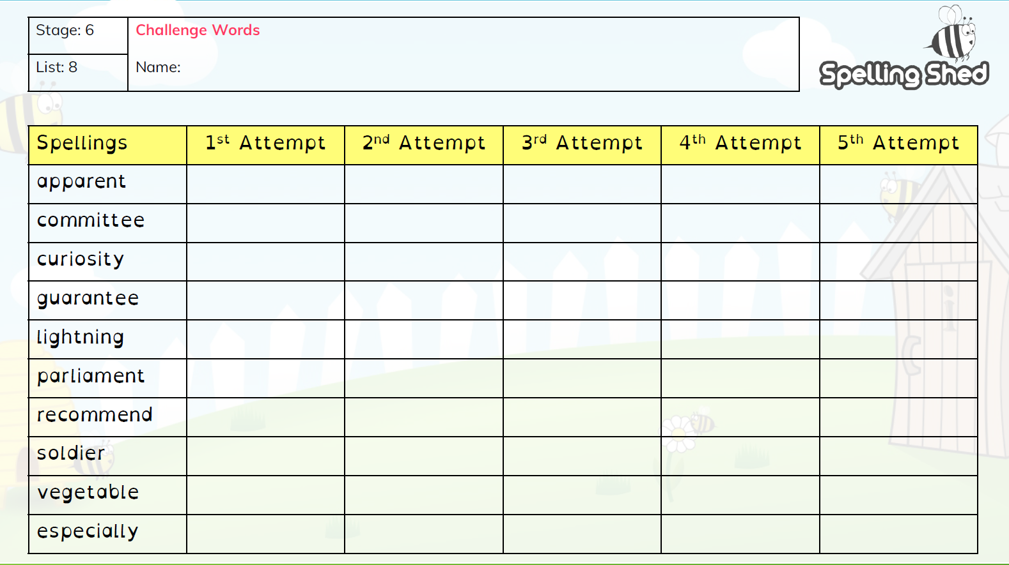
Year 6 Week 2 Term 3

Slide 3
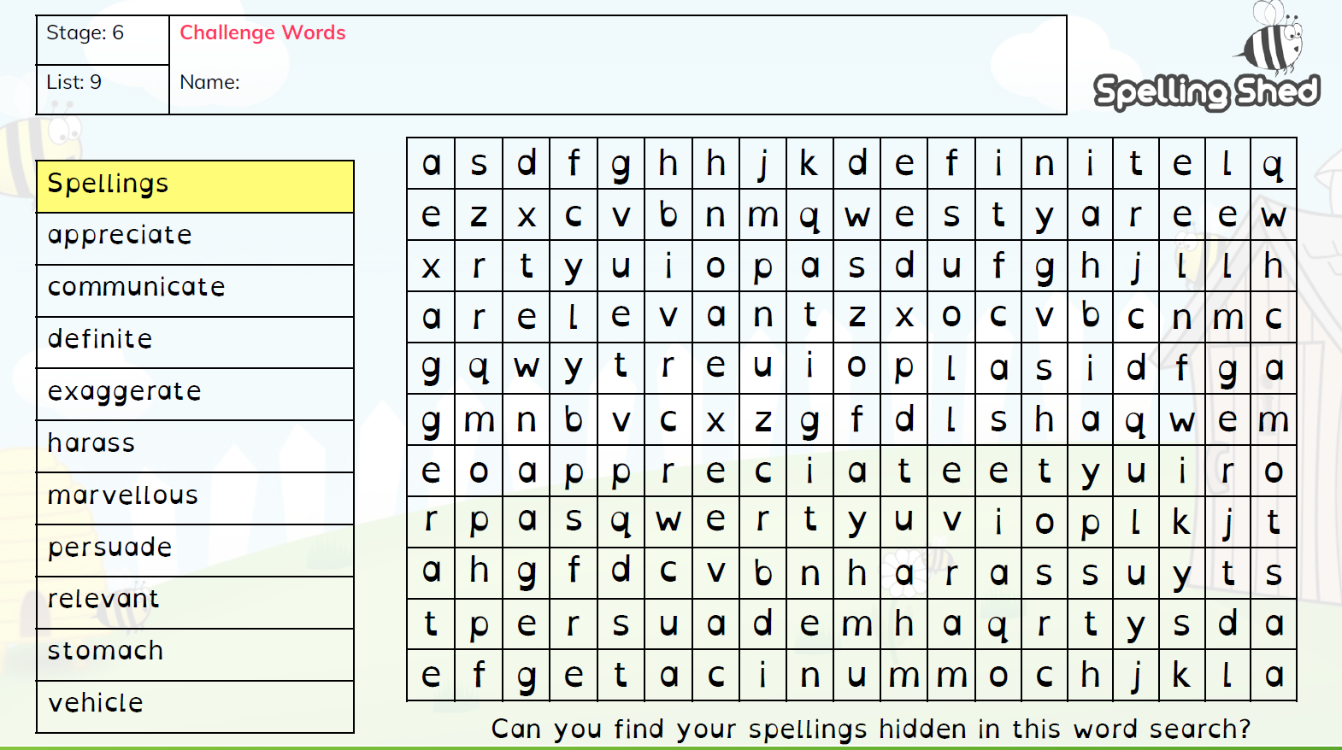
Year 6 Week 3 Term 3

Slide 4
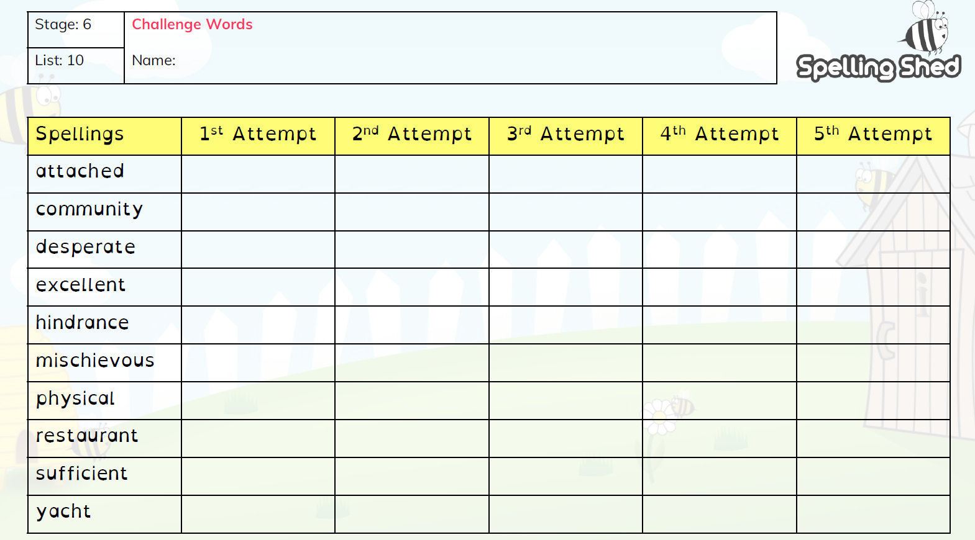
Year 6 Week 4 Term 3

Slide 5
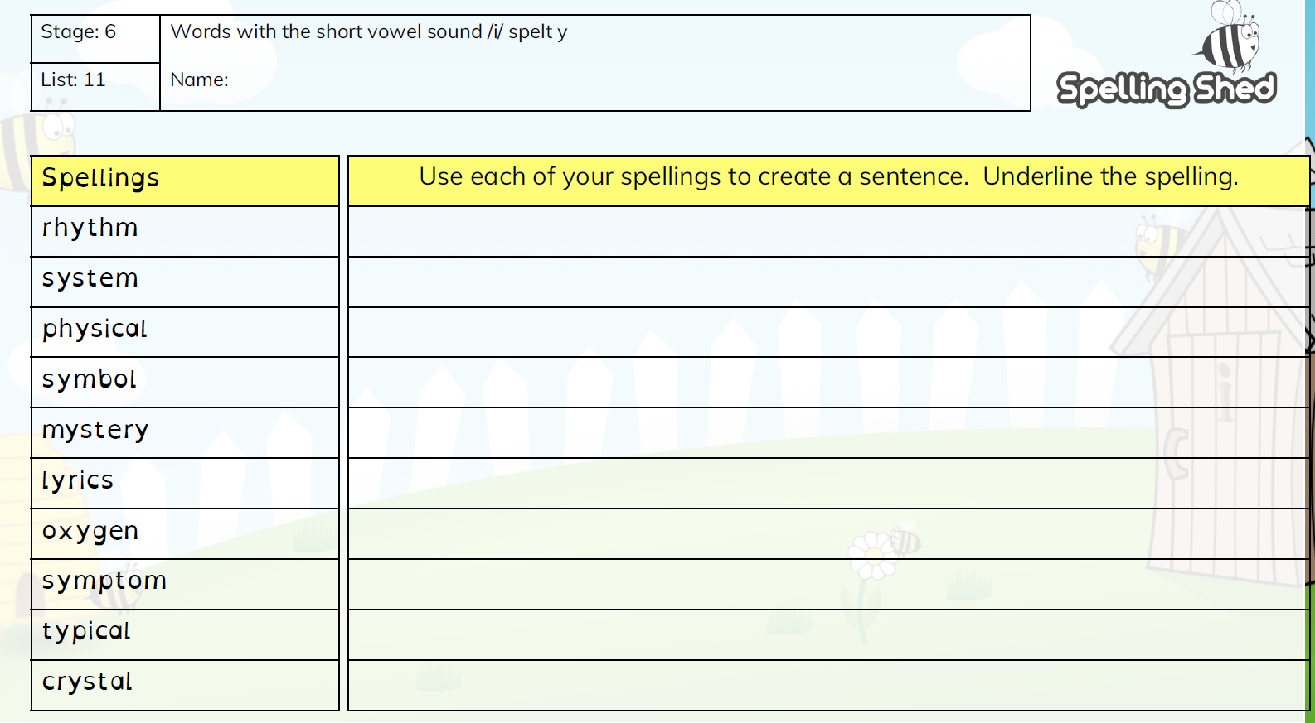
Year 6 Week 5 Term 3

Slide 6
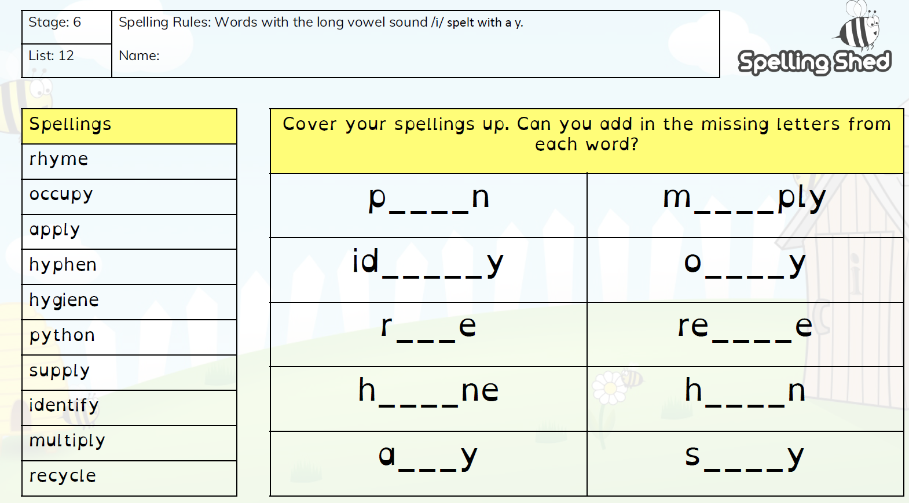
Year 6 Week 6 Term 3

