Slide 1
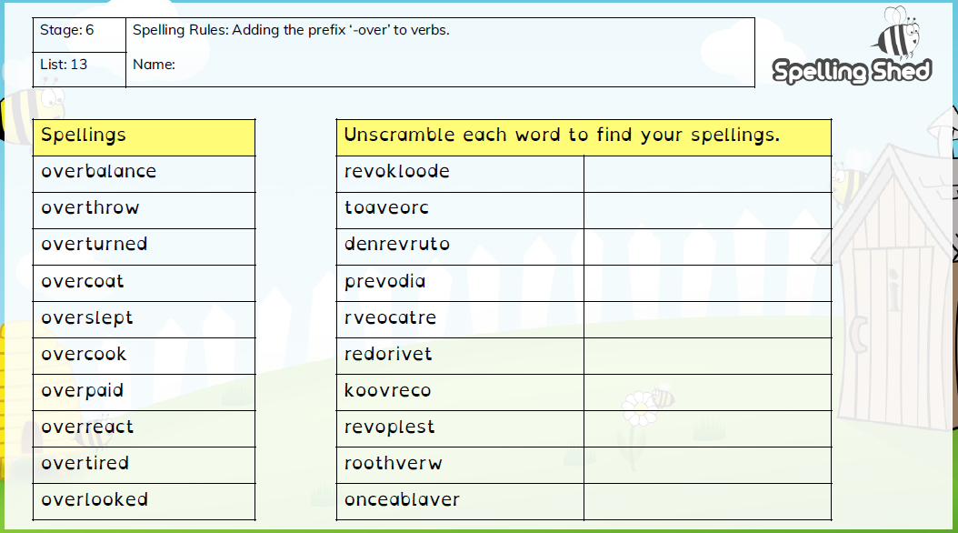
Year 6 Term 4 Week 1

Slide 2
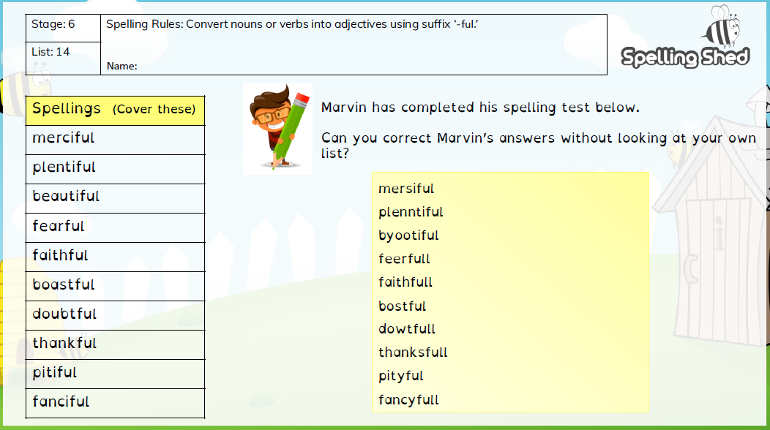
Year 6 Term 4 Week 2

Slide 3
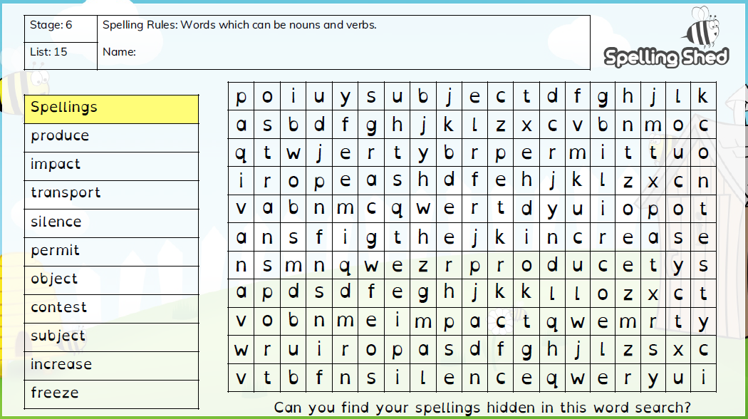
Year 6 Term 4 Week 3

Slide 4
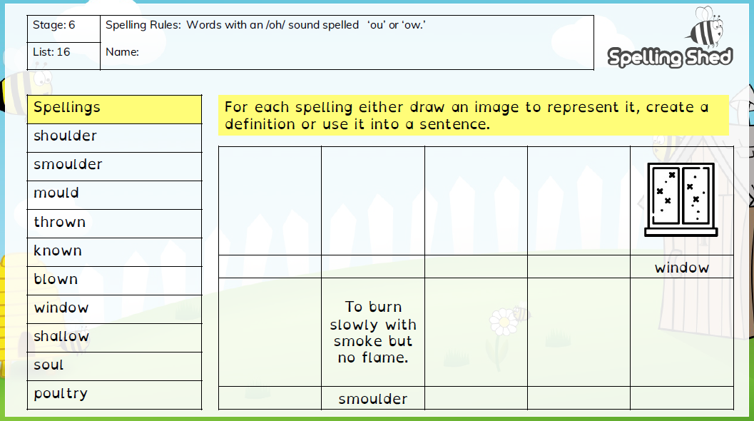
Year 6 Term 4 Week 4

Slide 5
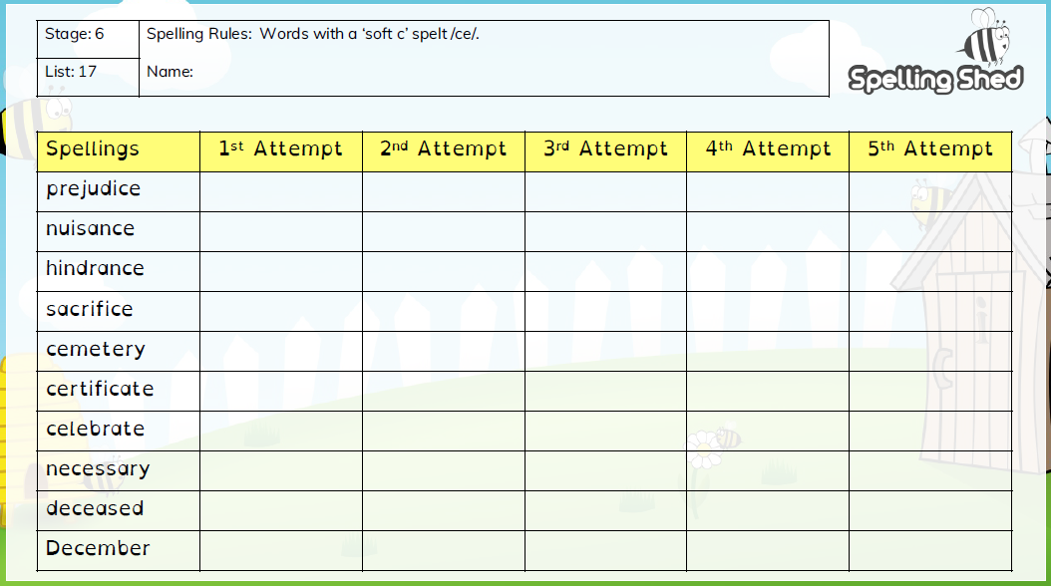
Year 6 Term 4 Week 5

