Slide 1

Assembly Monday 4th May

Slide 2
Co-Operation

Slide 3
Co-operation means working together to achieve something.

Slide 4

There is co-operation happening all around us. The parts of a tree co-operate to stay alive and grow.
The roots hold the tree firm.
The trunk pushes the tree up
high.
The leaves collect oxygen.

Slide 5
Many stories teach us about the importance of co-operation and how it can help us…
Here’s one…

Slide 6
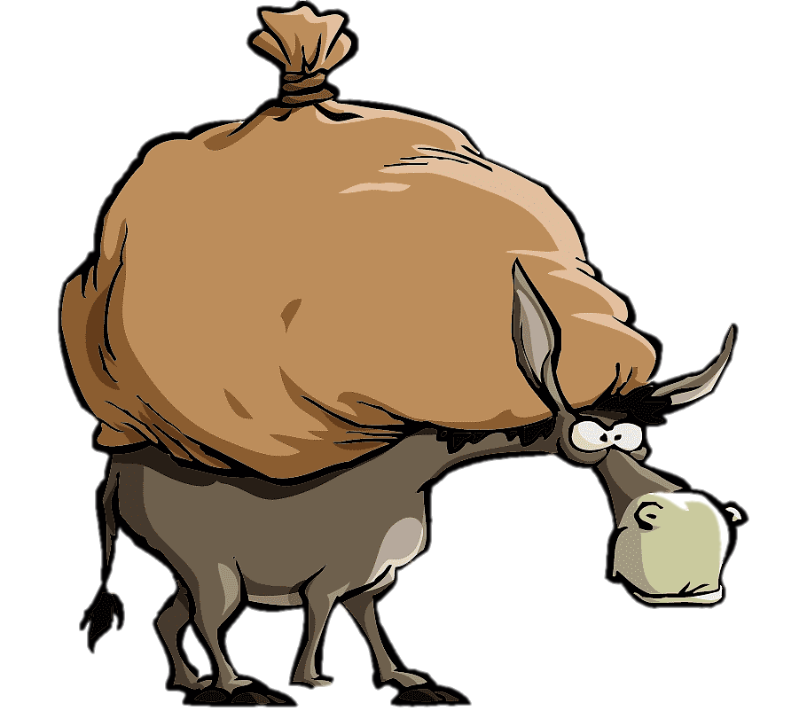
A salesman was carrying his goods on the back of a donkey but the donkey found it too heavy so he asked a mule for help.

Slide 7
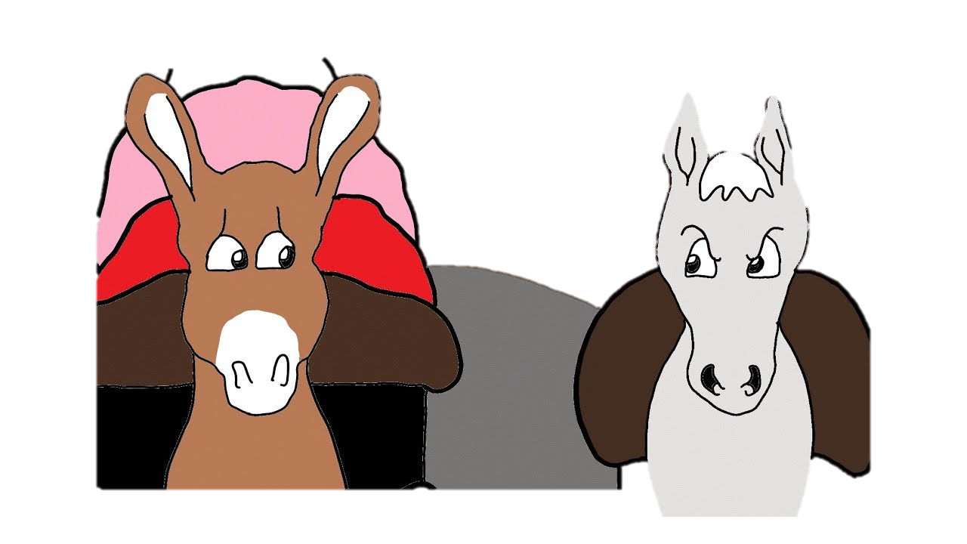
The mule said no because he didn’t want to carry anything.
The donkey kept on begging for help but the stubborn mule refused.

Slide 8
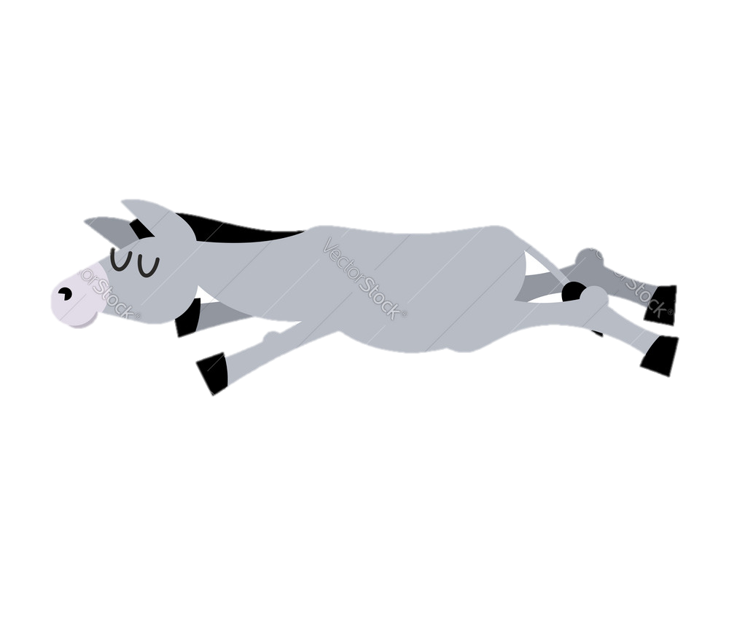
Eventually the donkey fell down tired. The salesman took all the goods off the donkey’s back and put them onto the mule.

Slide 9
The mule then begged the donkey to help, when he had recovered, but the donkey refused because the mule had refused to help him.

Slide 10
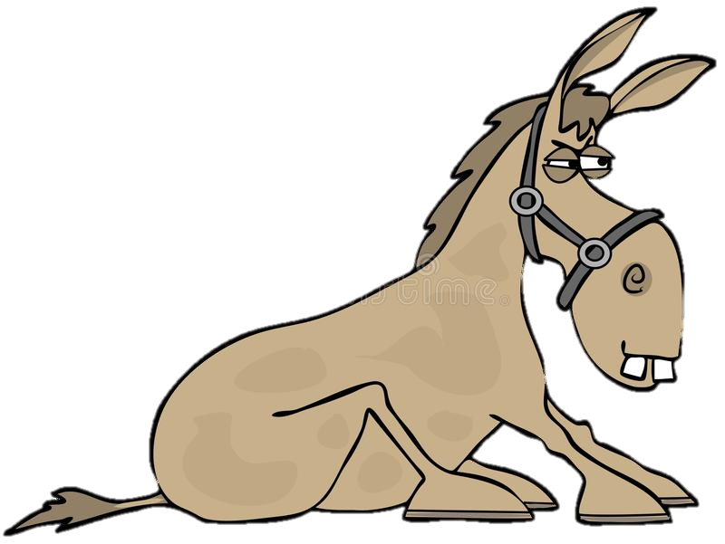
Then the mule fell down out of tiredness and the salesman could get none of his goods to the market.

Slide 11
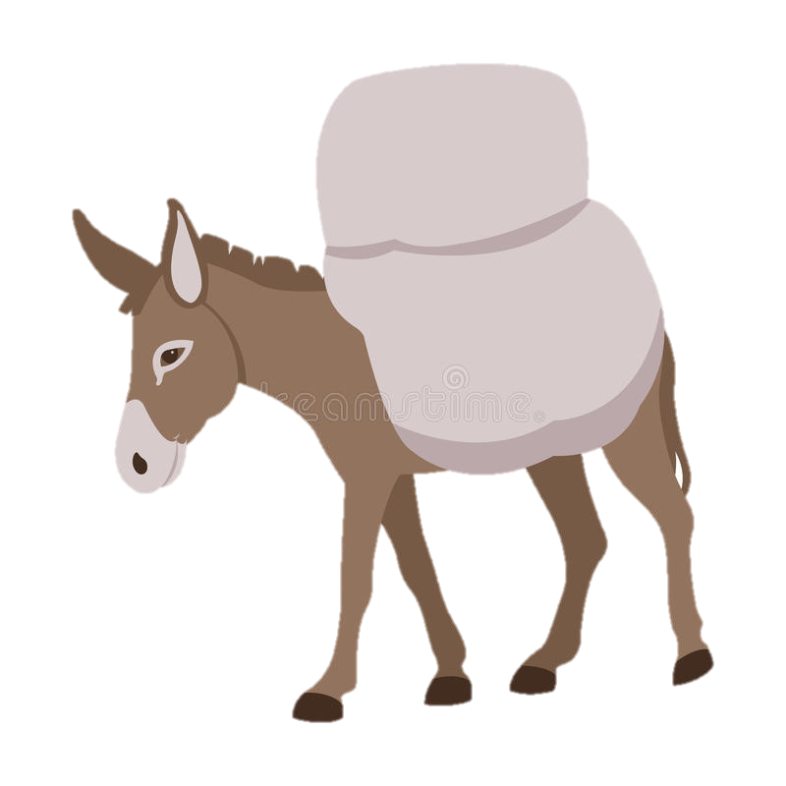
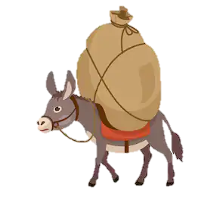
The next day the donkey was carrying the goods again and when it got too heavy he asked the mule for help. This time, the mule agreed and took half of the goods.

Slide 12
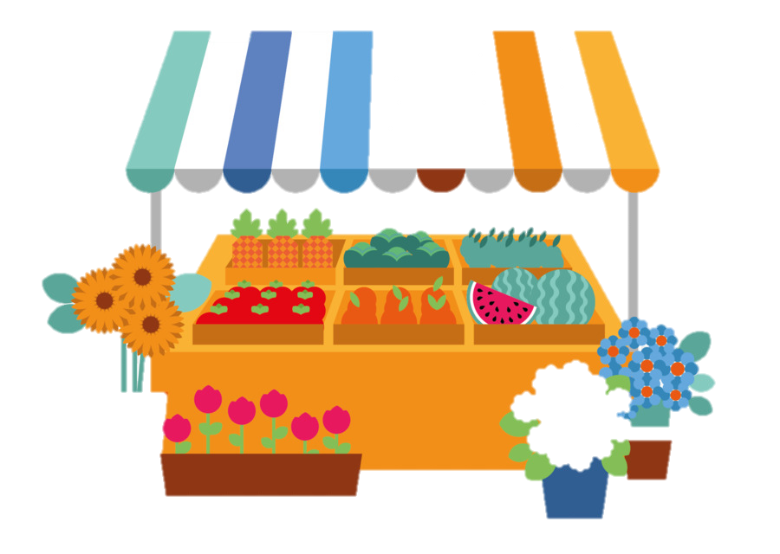
That day all the goods got to the market because the donkey and the mule had co-operated.

Slide 13
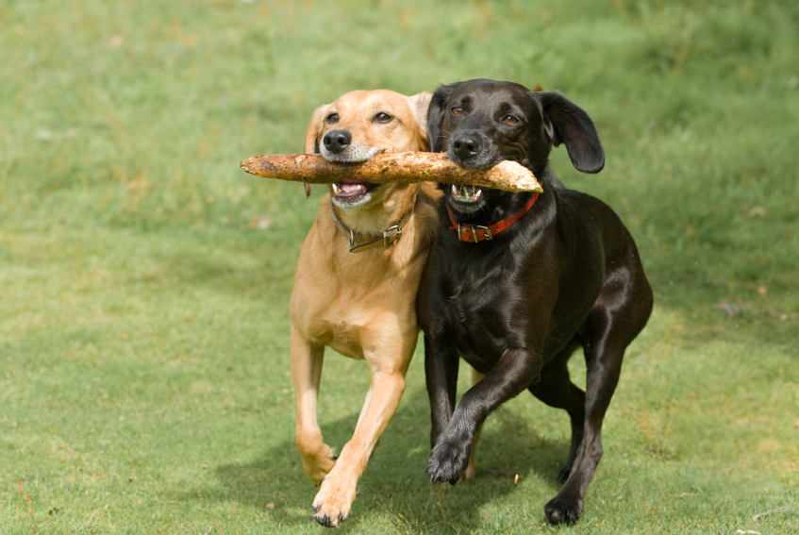
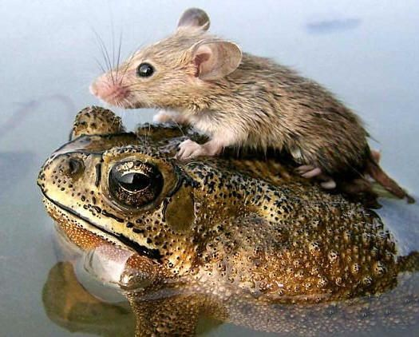
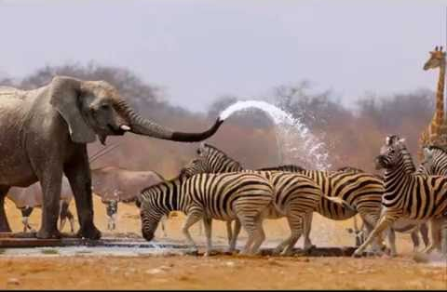
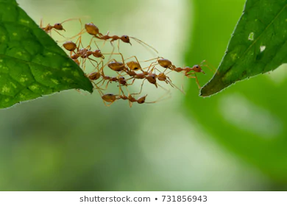
Co-operation around us!

Slide 14
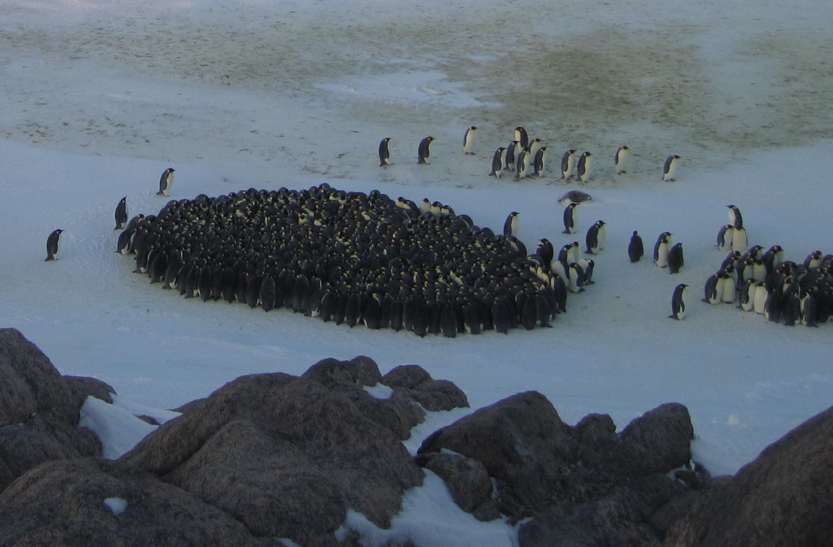
Penguins co-operate to keep warm. They huddle together and when the penguins on the outside of the circle get cold they move into the middle.
This keeps them
all warm and safe.

Slide 15
Ecclesiastes 4:9-12
Two are better than one because they have a good return for their work.
If either of them falls, the other will pick up his companion.
But woe to the one who falls when there is not another to pick him up.

Slide 16
As a challenge to try co-operating at home, try to make a chair with someone else to support another person in your family.
Clue: stand opposite your partner, cross your hands and hold each others’ hands.
If you can, take a picture send it to Ms Warren!

Slide 17
Prayer
Dear God,
Be with us in our homes today
In our work and in our play
Be in our hearts, be in our minds
In all we do and say.
Teach us how to grow in love
Each and every day.
Amen

Slide 18
Think about how you can co-operate in your family this week. What will you achieve together?

Slide 19
Here I am to worship – a very religious and beautiful song today.
https://www.youtube.com/watch?v=CoxopsRSfdU

