Slide 1
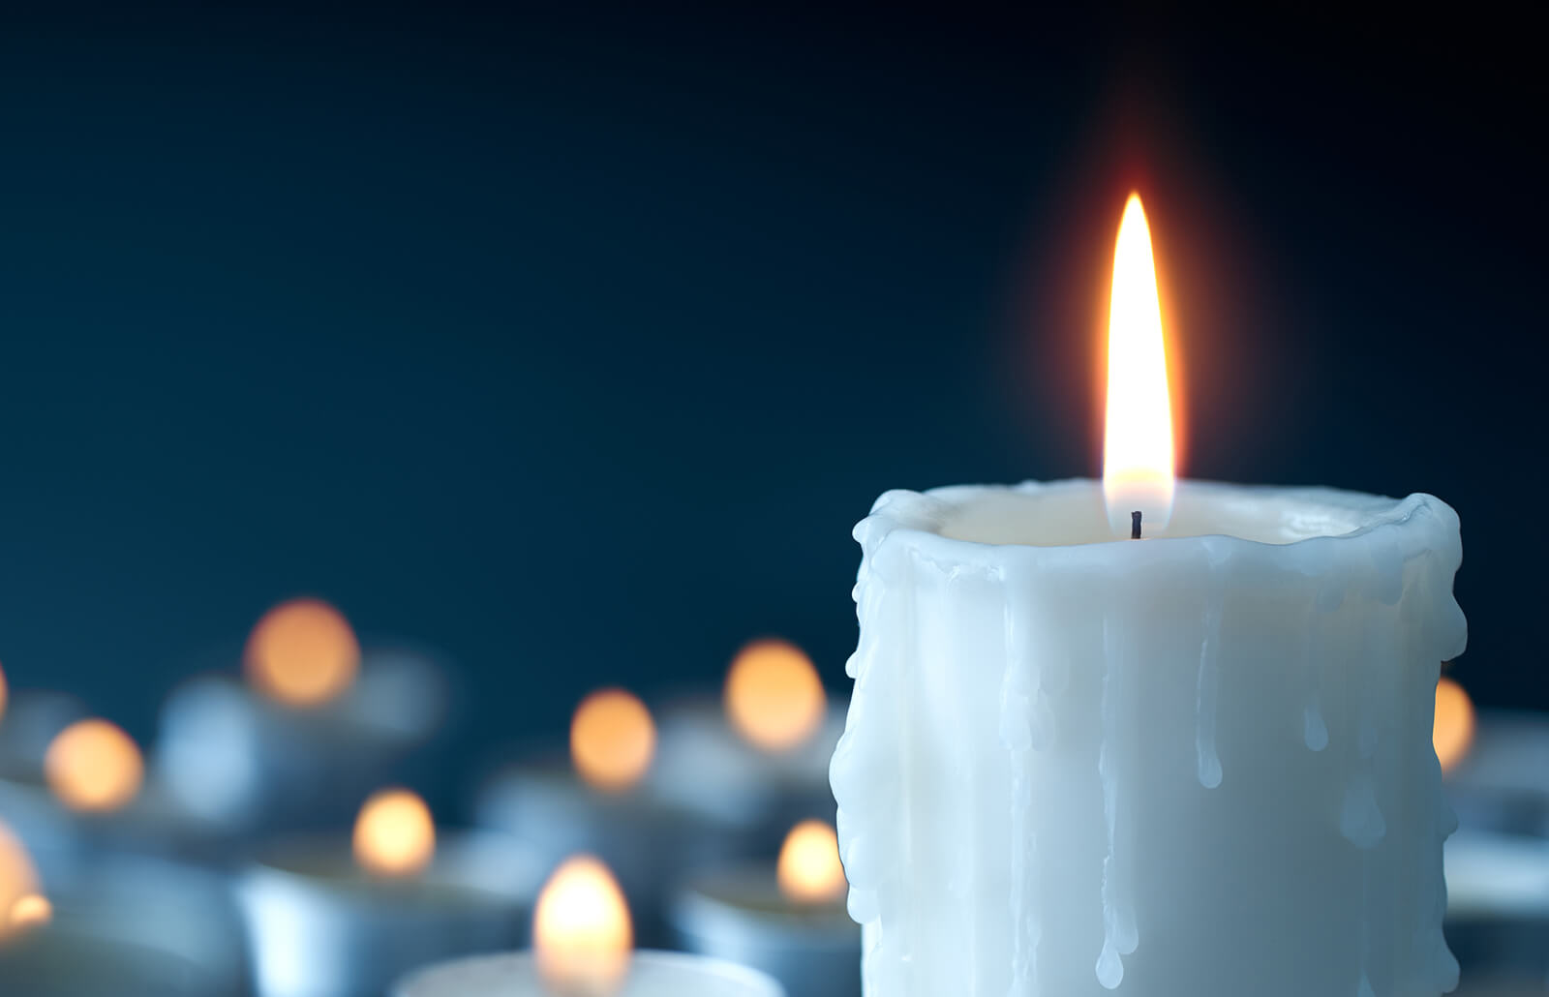
Assembly Monday 29th June

Slide 2
Appreciation

Slide 3
Appreciation means feeling grateful and thankful for the things and people in our lives.

Slide 4
We can show appreciation for people in many ways.
Can you think of any ways you show appreciation?

Slide 5
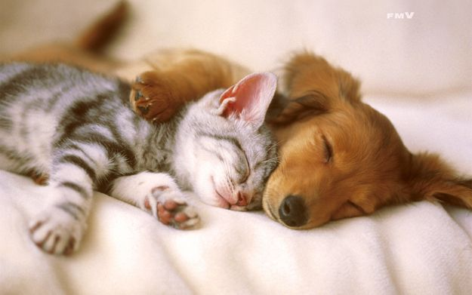
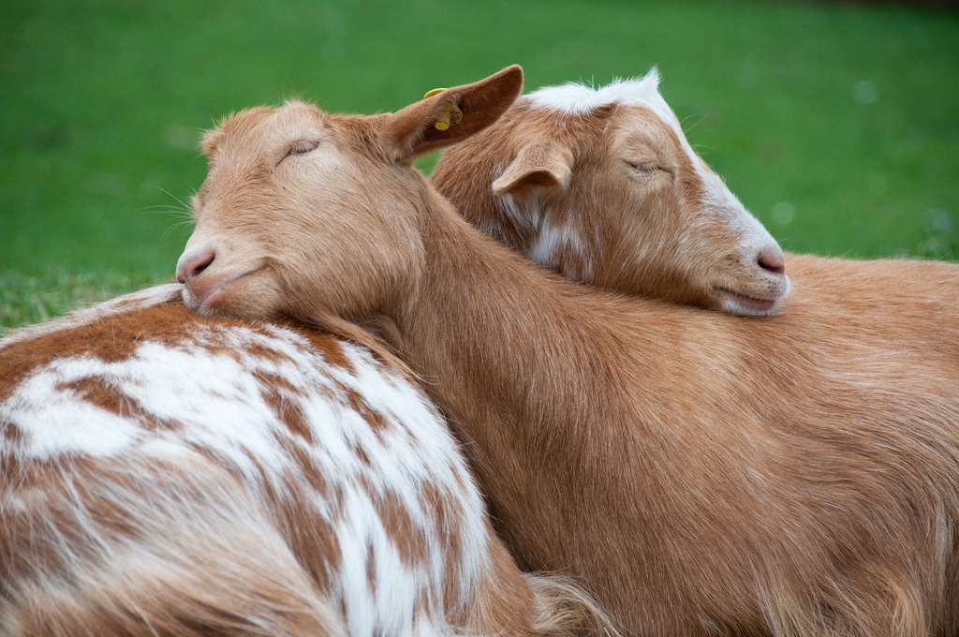
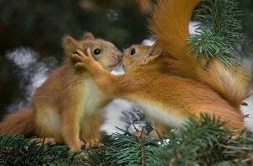
We can show people we appreciate them through giving them hugs.
We can say ‘Thank You’ when they do nice things for us.
Do something nice for them.

Slide 6
We can learn how important appreciation is through the story of Androcles and the Lion.

Slide 7
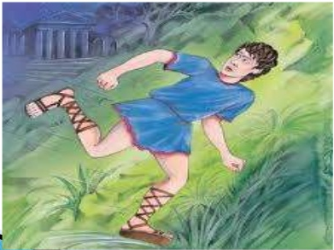
Androcles was a slave and he escaped from his master. He ran into the jungle where he found a lion with an injured leg; he was limping.

Slide 8
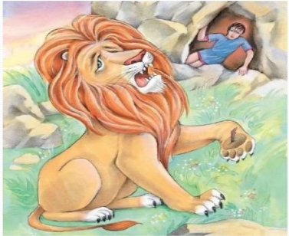
The lion came up to Androcles but he didn’t attack him, he held out his paw. Androcles saw that there was a thorn in his foot which was causing him pain.

Slide 9
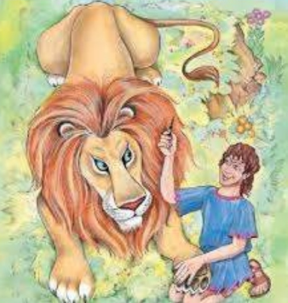
Androcles held the lion’s paw and pulled out the thorn. The lion roared in pain but he didn’t attack Androcles.

Slide 10
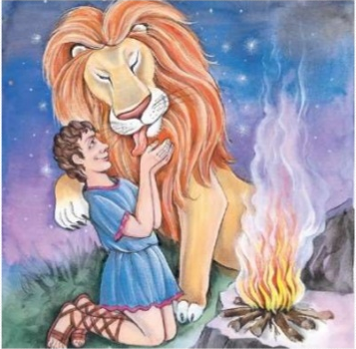
The lion was very grateful, he jumped up and started licking Androcles to show his appreciation.

Slide 11
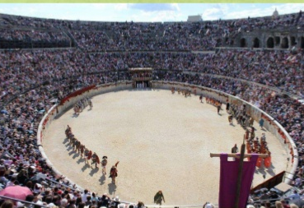
However, Androcles was captured and his punishment was fighting in the Colosseum against a hungry lion. He was very scared.

Slide 12
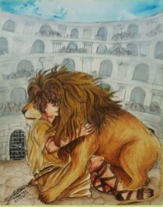
But when they released the lion it was the same lion Androcles had helped. The lion ran up to him and gave him a hug.

Slide 13
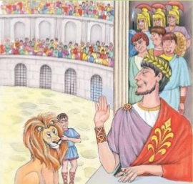
The Emperor made Androcles explain what had happened. Androcles told him about their friendship. The Emperor was touched by their story.

Slide 14
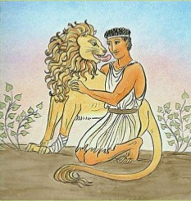
The Emperor freed Androcles and the lion and they went to live in the wild together.

Slide 15
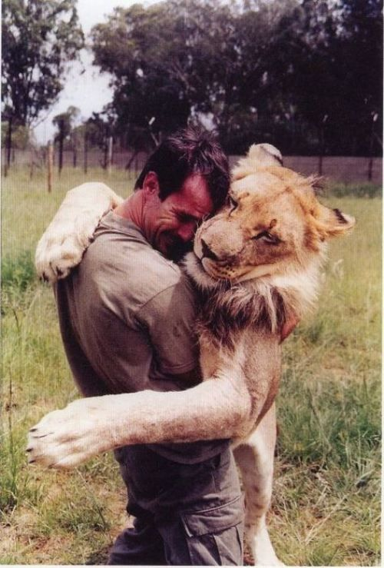
This shows us how important appreciation can be. The lion showed his appreciation to Androcles for helping him by giving him a hug and thanking him. It is important that we also act like the lion when we show appreciation.

Slide 16
Lockdown has made us appreciate the small things in our lives a lot more. We appreciate our families and all the kind things they do for us. It is important to show that we appreciate these things.

Slide 17
Psalm 118:1
Give thanks to the Lord, for he is good;
his love endures forever.

Slide 18
Dear God,
Be with us in our homes today,
In our work and in our play,
Be in our hearts and in our minds,
In all we do and say,
Teach us how to grow in love,
Each and every day,
Amen.

Slide 19
https://www.youtube.com/watch?v=njsdfxK9FcQ

