Slide 1
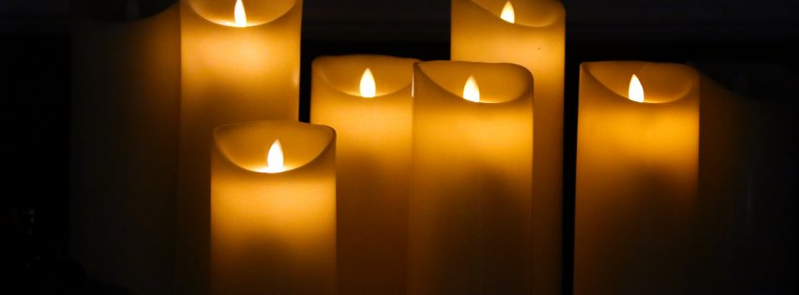
Assembly Monday 15th June 2020

Slide 2
Responsibility

Slide 3
Last week we talked about the Black Lives Matter protests that are happening across the world. People want unfairness to stop. They want all people to be treated equally and given the same respect.

Slide 4
There are different ways of protesting. You may have seen them on the news.
Do you know what they are?

Slide 5
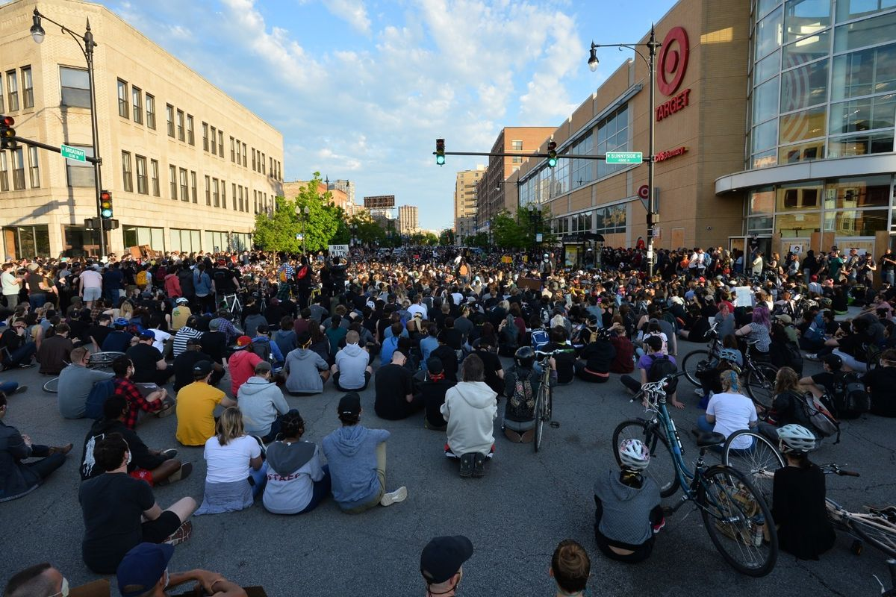
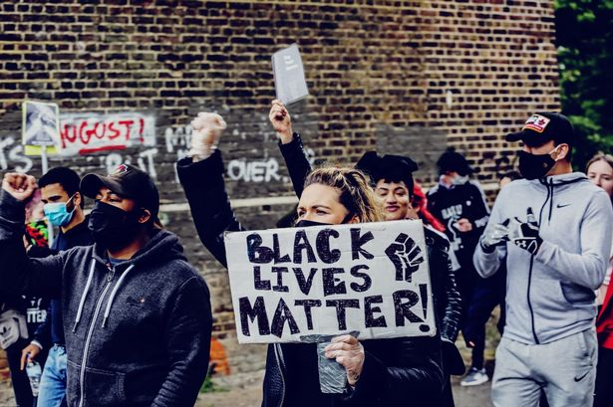
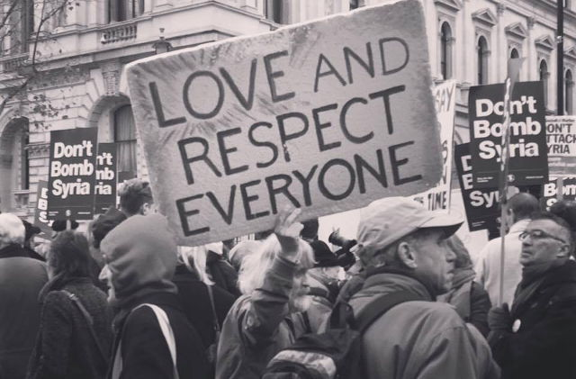
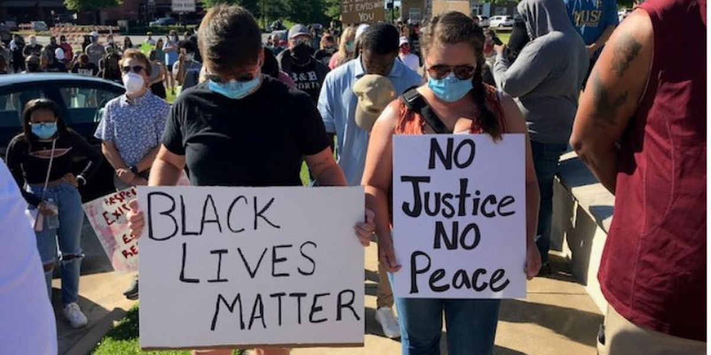
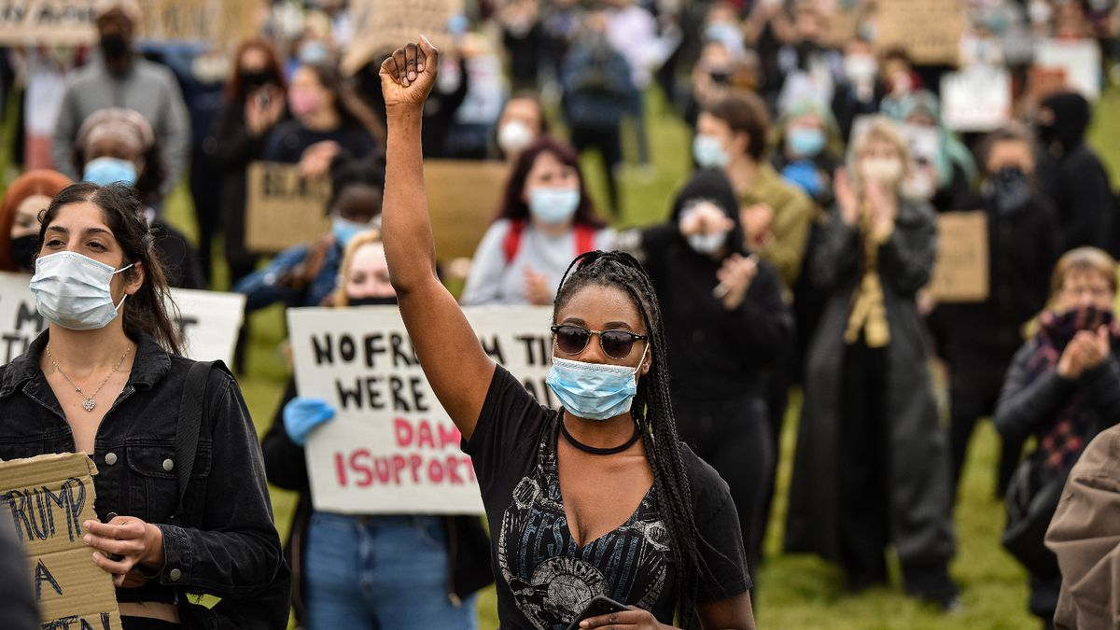
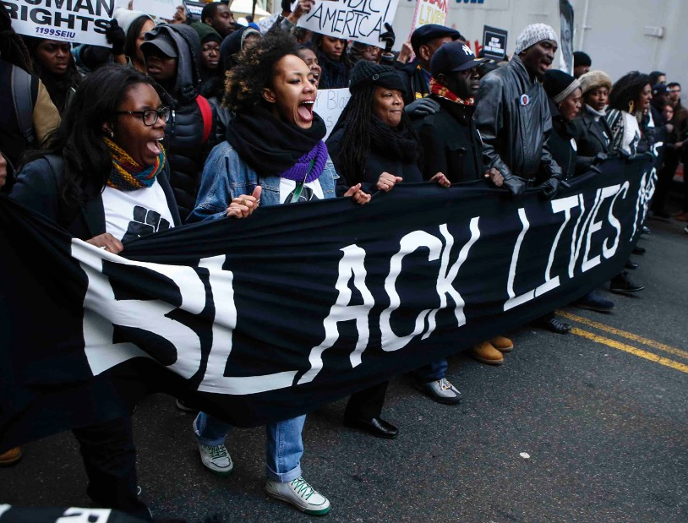
There are peaceful protests.

Slide 6
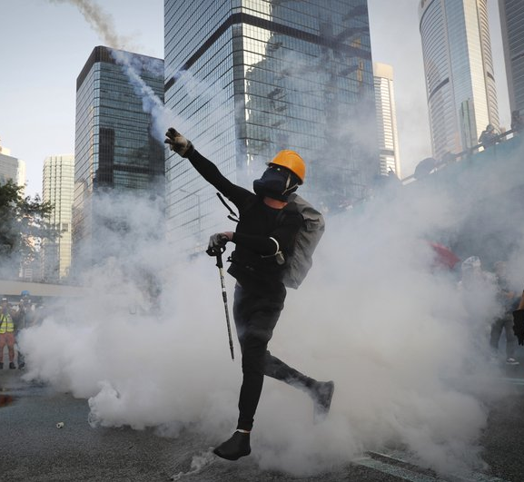
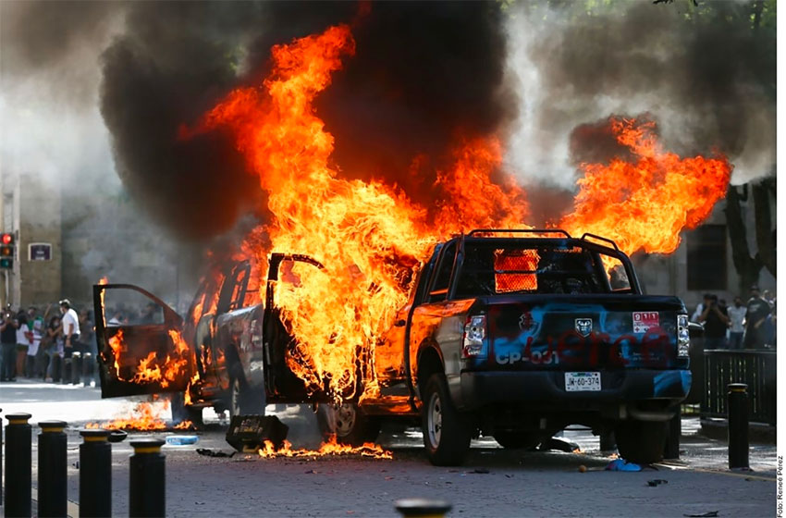
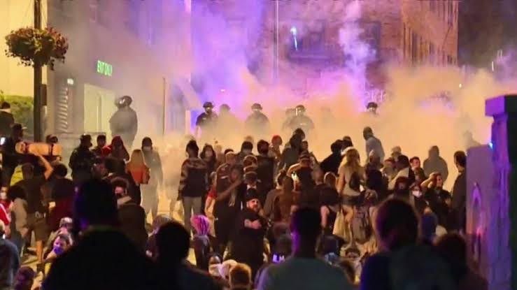
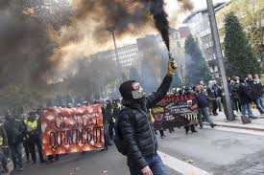
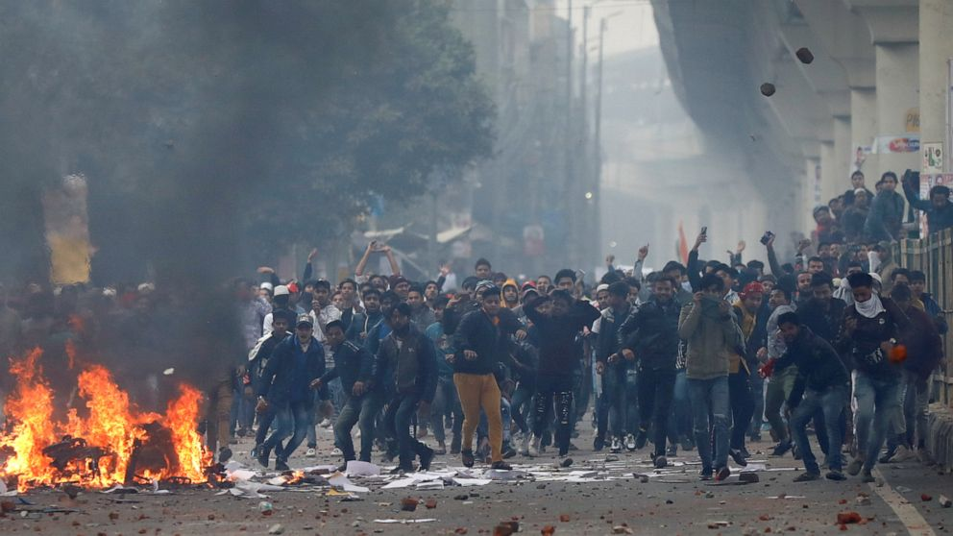
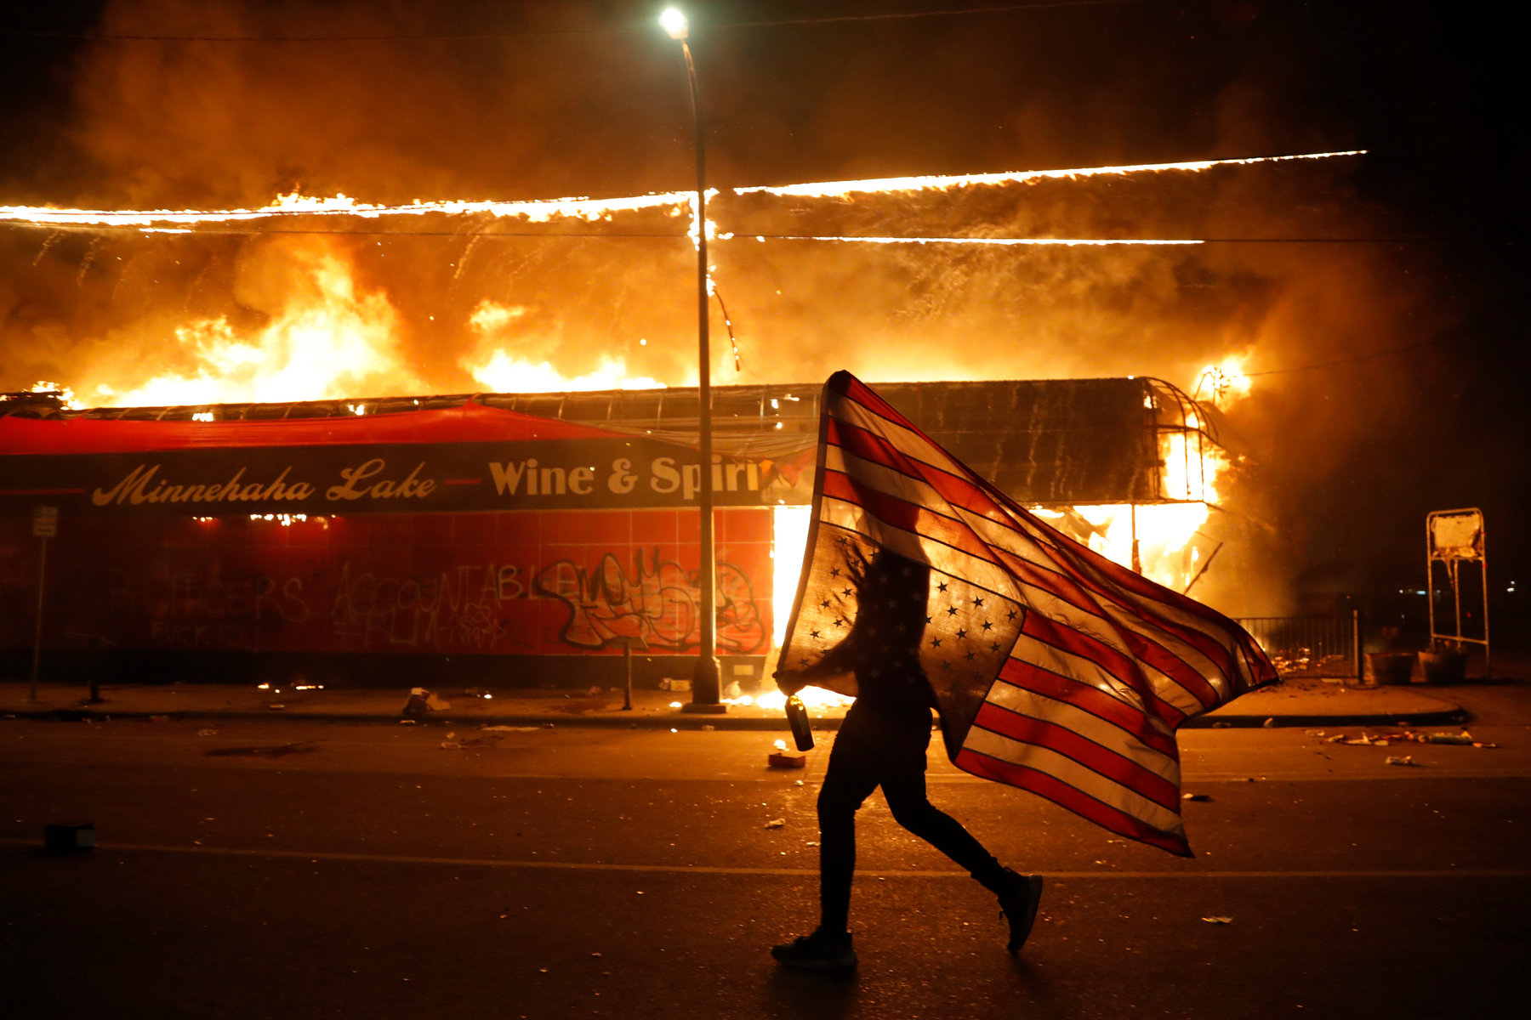
And sadly, there are violent protests.

Slide 7
Which way of standing up for what you believe is right?
Which do you think is the most responsible way to make a difference?

Slide 8
Peaceful protest is the most responsible!
It is also much more likely to be successful; there are many examples of peaceful protest leading to change for the better.

Slide 9
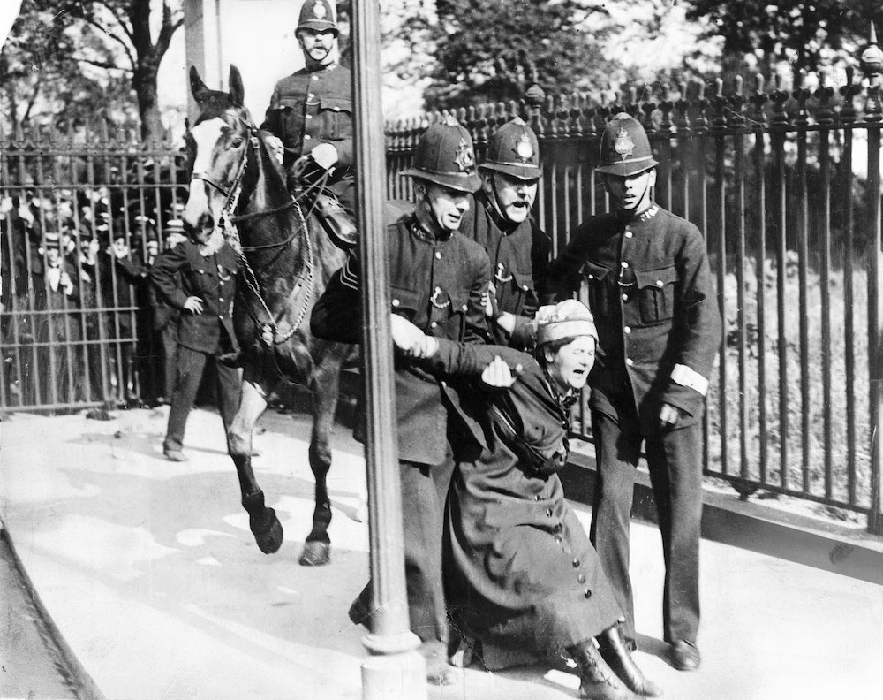
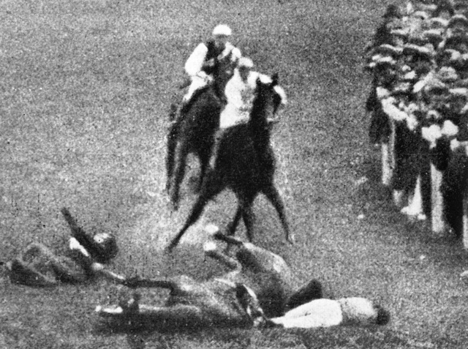
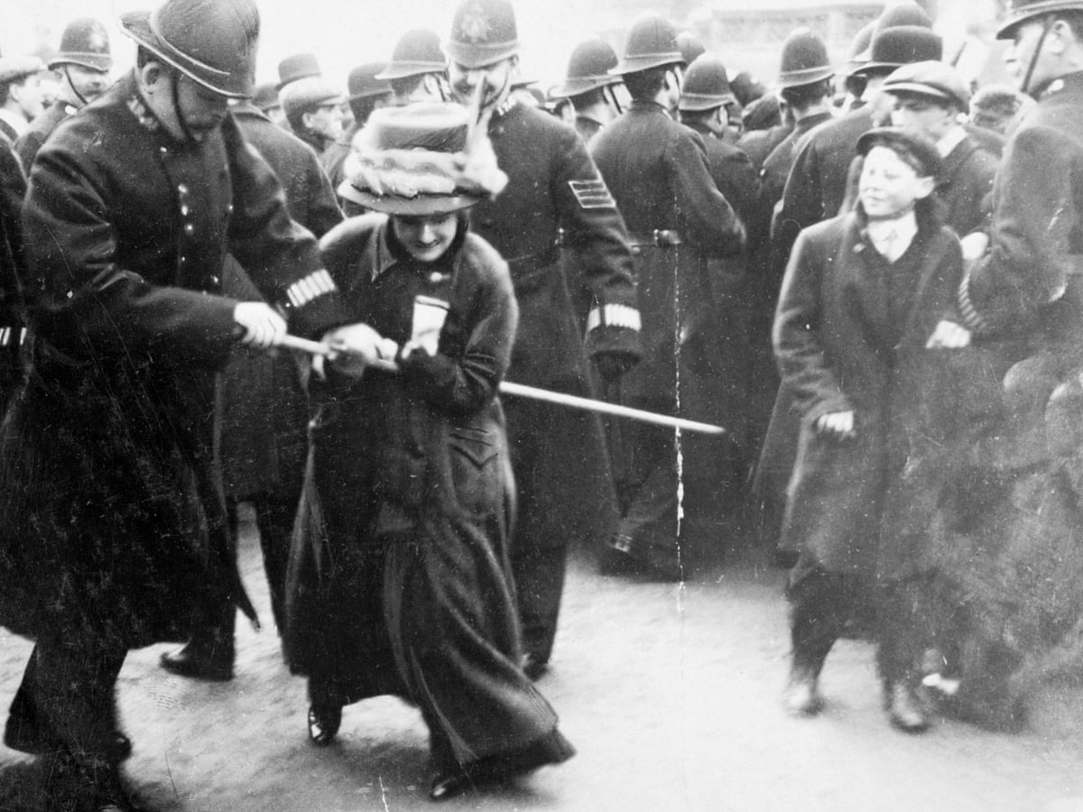
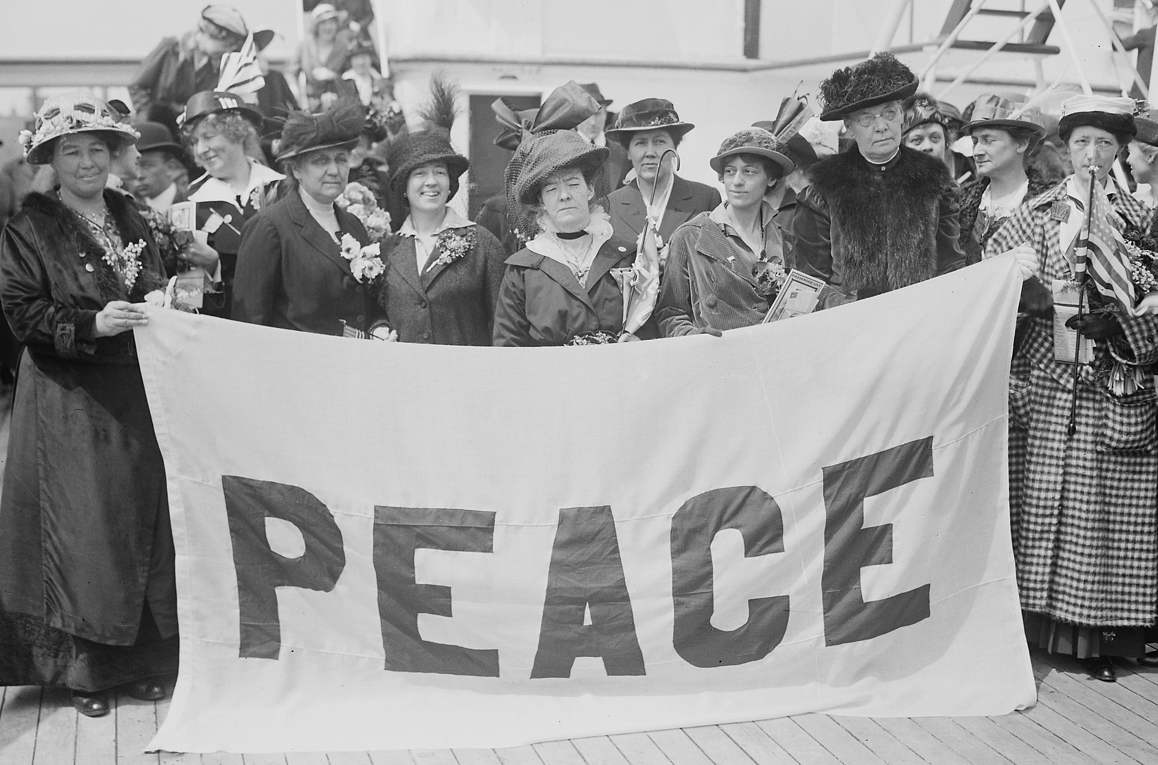
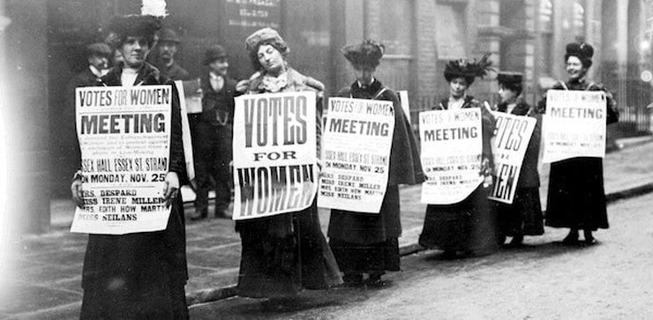
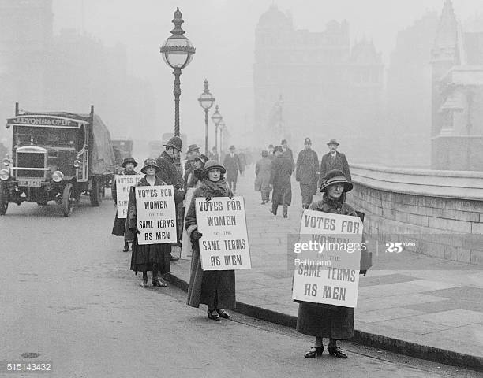
Before the First World War, there were two groups of female protestors who wanted women to be able to vote for who would be in government. The Suffragettes, who were violent.
And the Suffragists, who were peaceful. It took a long time, but they were successful in the end.

Slide 10
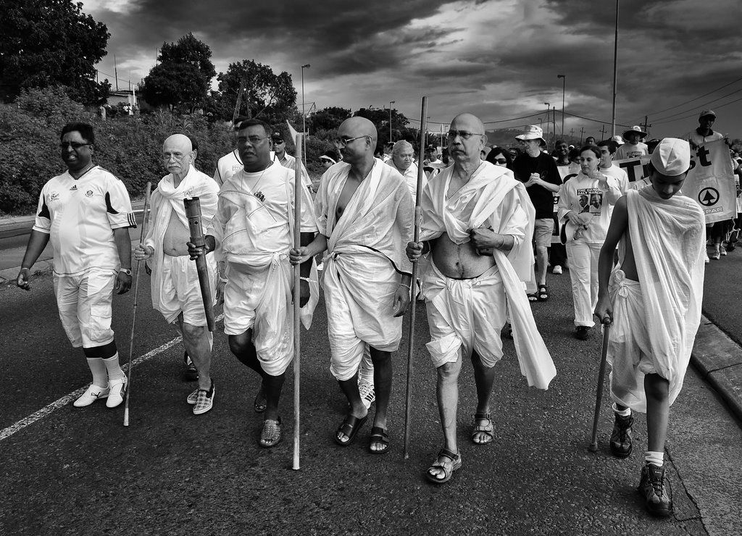
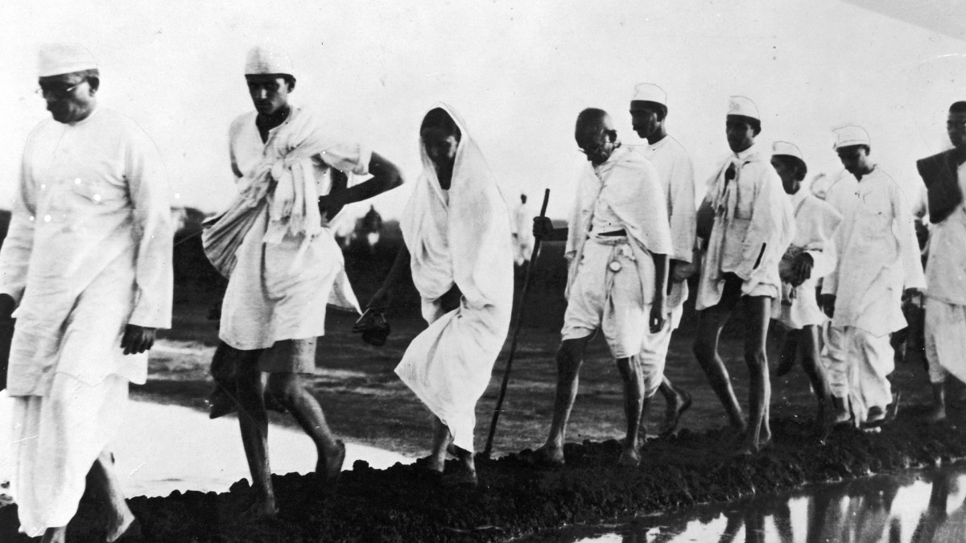
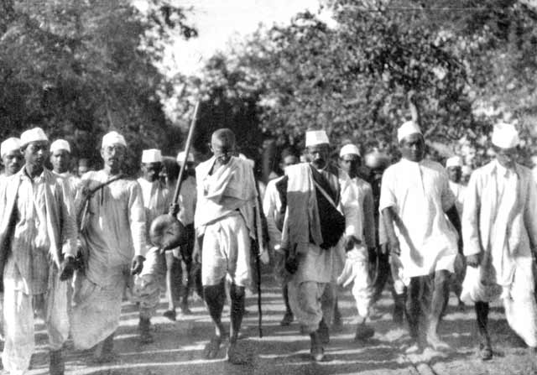
Gandhi led ‘The Salt March,’ a 241 mile peaceful protest march because he was angry that Britain made the rules about what could happen in his country, India.
Eventually he was successful and India was given its independence from Britain. Its people were free to make their own rules.

Slide 11
Violent protest is irresponsible and can have bad consequences. People can be badly hurt and buildings and other things can be damaged and broken.

Slide 12

This quote from 1839 is still true today. It explains how peaceful protest is responsible and more powerful than violent protest – it is very important to remember this.
"The pen is mightier than the sword"
Edward Bulwer-Lytton 1839

Slide 13
Stand up for what is right
but….....
do it in the right way!

Slide 14
Where do we get the courage from to stand up for others?

Slide 15
Psalm 23
The Lord is my shepherd, I lack nothing.
He makes me lie down in green pastures,
He leads me beside quiet waters, he refreshes my soul.
He guides me along the right paths for his name’s sake.
Even though I walk through the darkest valley,
I will fear no evil, for you are with me;
your rod and your staff, they comfort me.
You prepare a table before me
in the presence of my enemies.
You anoint my head with oil; my cup overflows.
Surely your goodness and love will follow me
all the days of my life,
and I will dwell in the house of the Lord forever.

Slide 16
Dear God,
Be with us in our homes today
In our work and in our play
Be in our hearts and in our minds
In all we do and say
Teach us how to grow in love
Each and every day.
Amen

Slide 17
https://www.youtube.com/watch?v=pN4tPkX0MG0
Enjoy and feel at peace – ready for the rest of your day ☺

