Slide 1
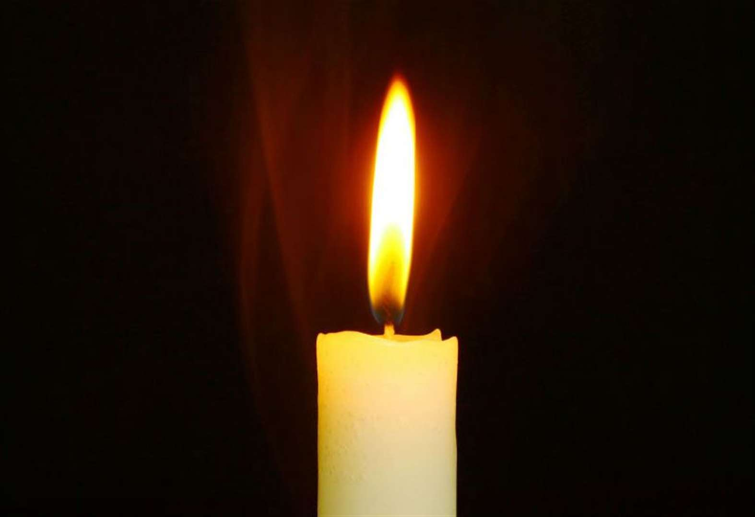

Slide 2
Our values this term
Friendship
Co-operation…......

Slide 3
Responsibility

Slide 4
Doing the things we should do.

Slide 5
We have to focus on being responsible a lot at the moment by keeping socially distanced when we’re near other people and washing our hands to keep them clean.

Slide 6
We have moral responsibilities which means standing up for things we believe in and not being scared to say what we think.

Slide 7
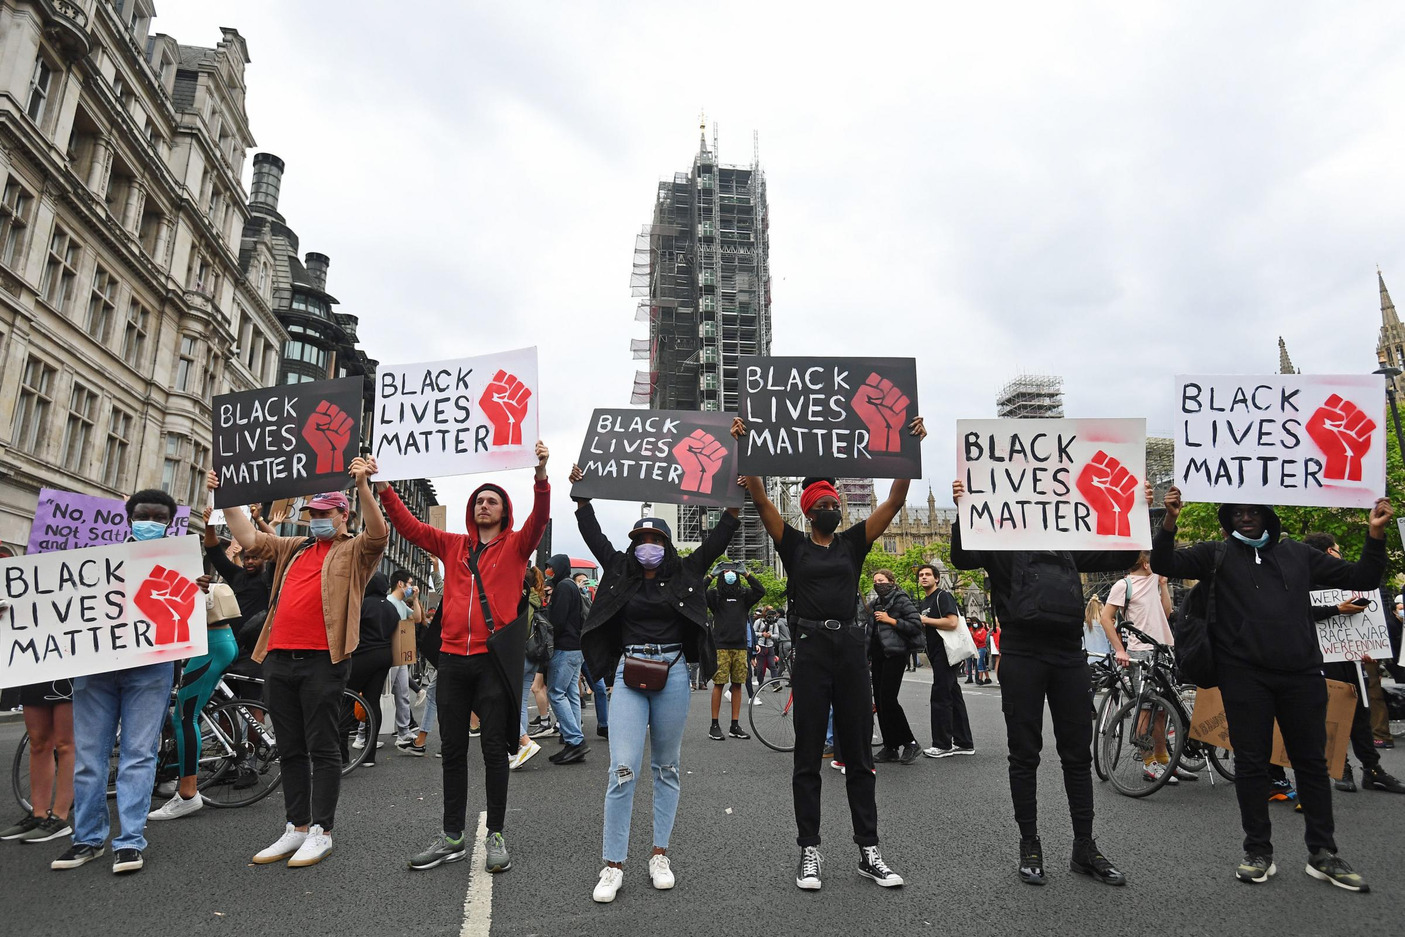
I expect you have seen in the news about the Black Lives Matter protests in America this week.
It is our responsibility to support this and show our compassion.

Slide 8
I want to tell you a story to help you understand why people are so angry. It’s called Tusk Tusk.
What animals do you think are in it?

Slide 9
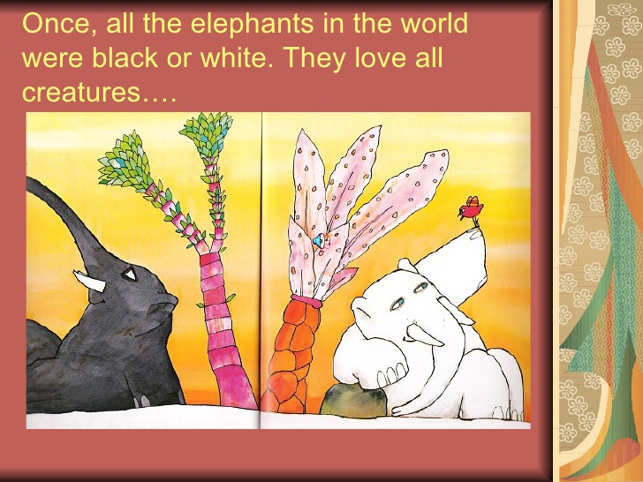

Slide 10
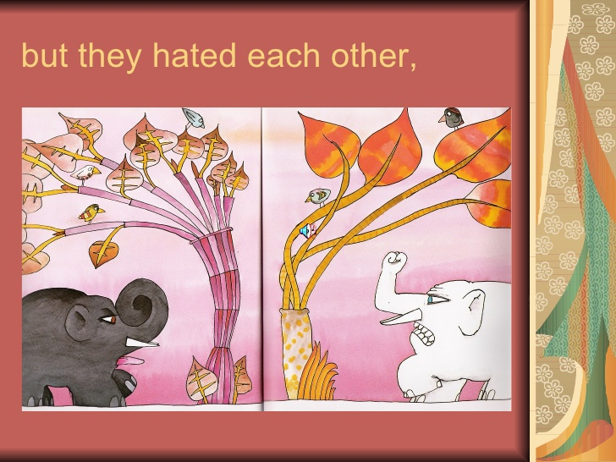

Slide 11
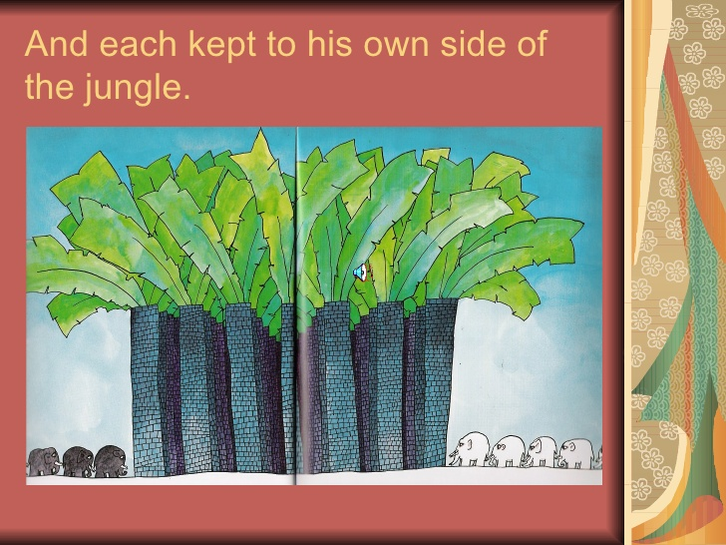

Slide 12
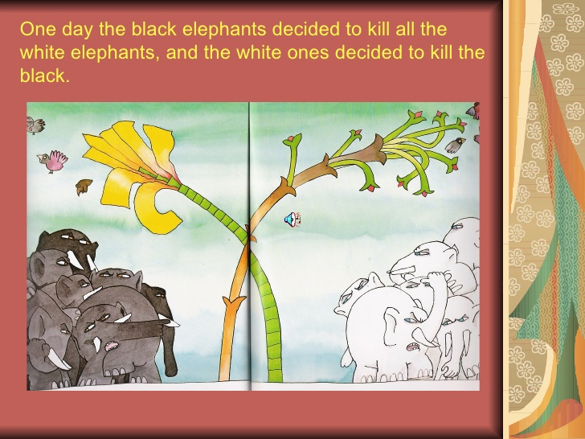

Slide 13
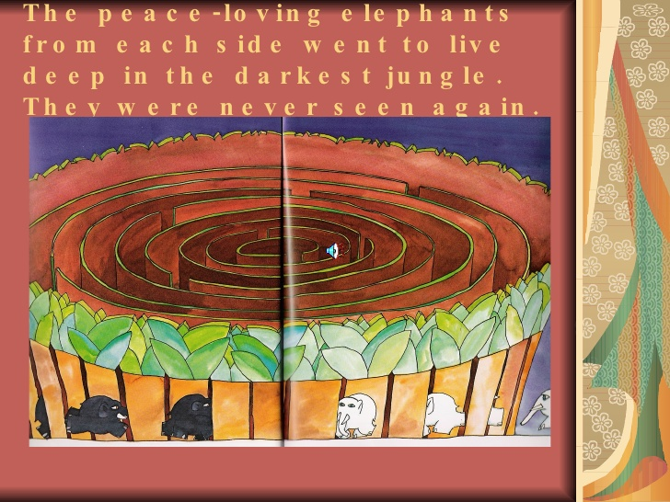

Slide 14
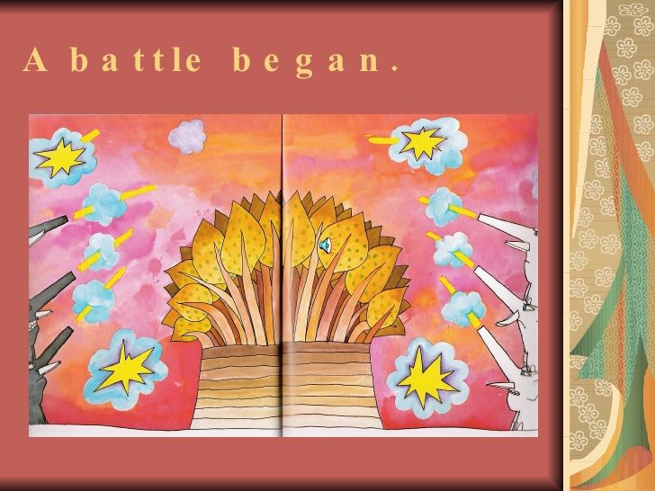

Slide 15
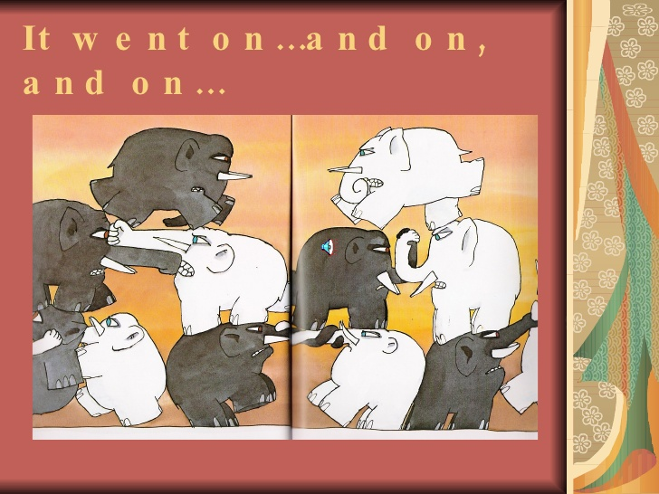

Slide 16
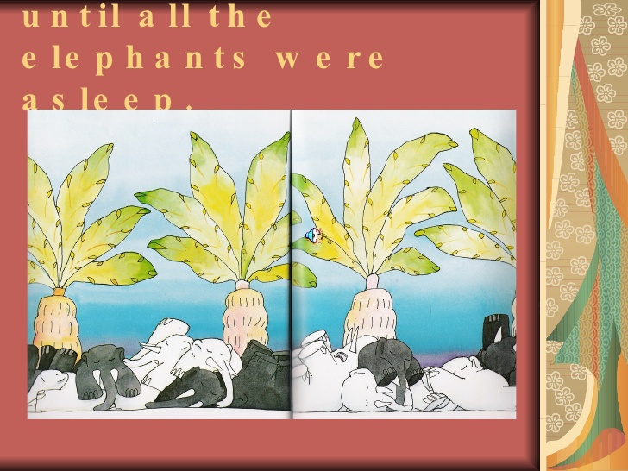

Slide 17
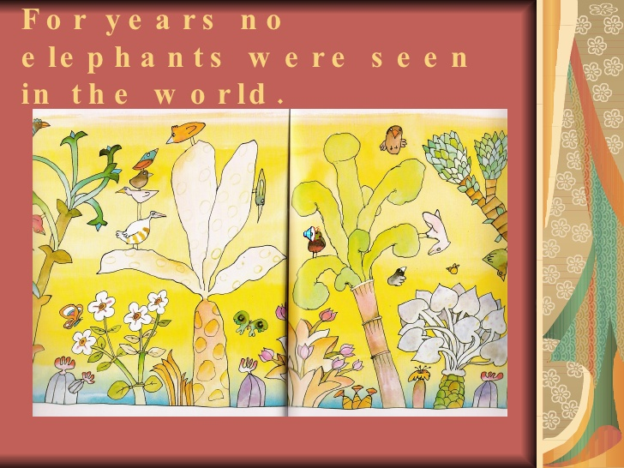

Slide 18
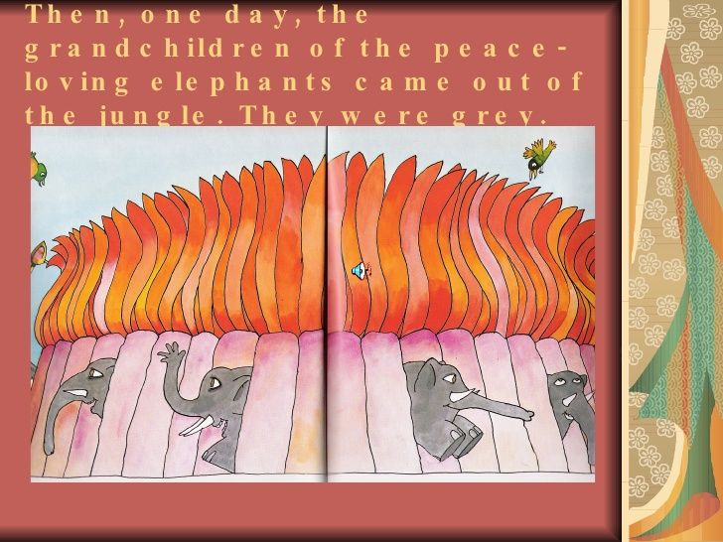

Slide 19
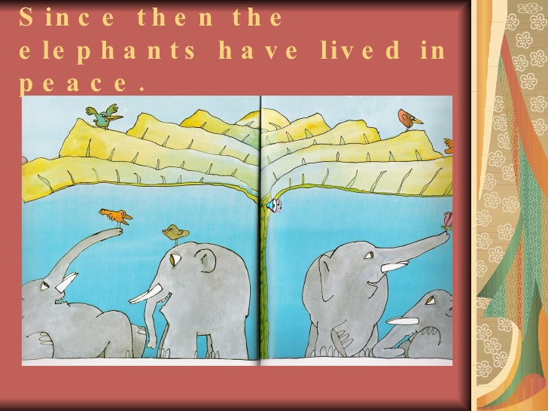

Slide 20
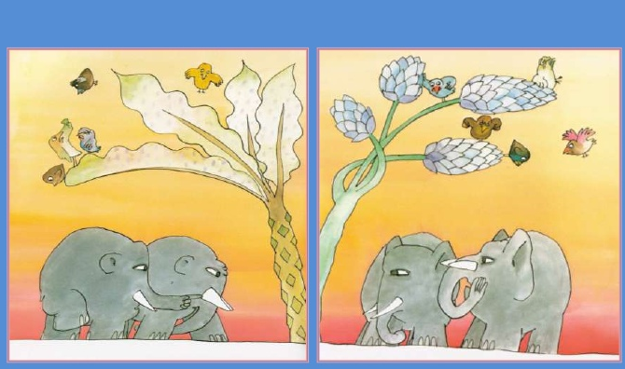
But lately, the small eared elephants have been looking at the big eared elephants strangely…

Slide 21
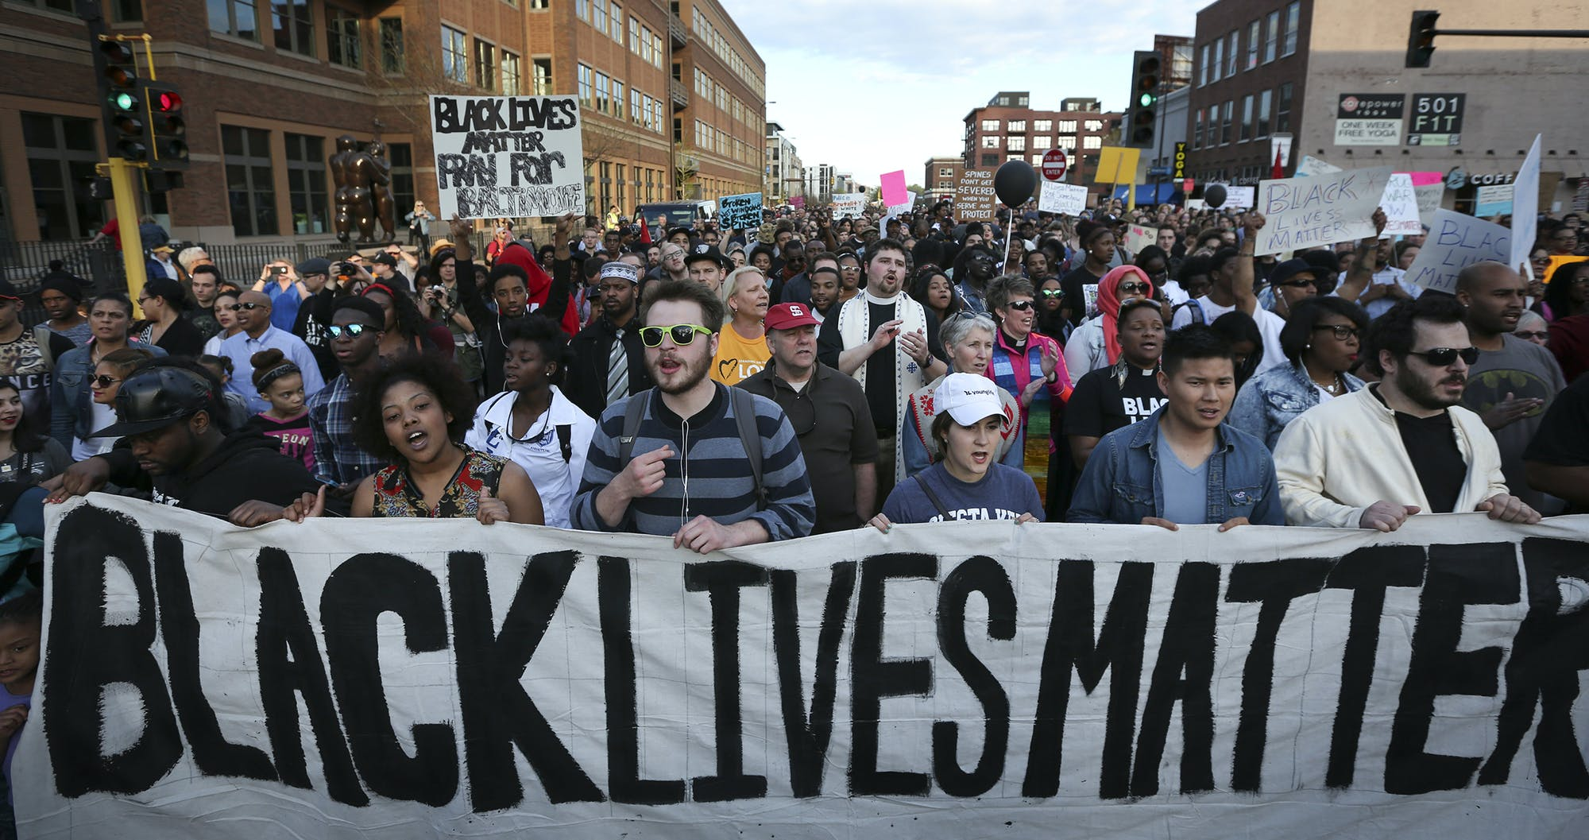
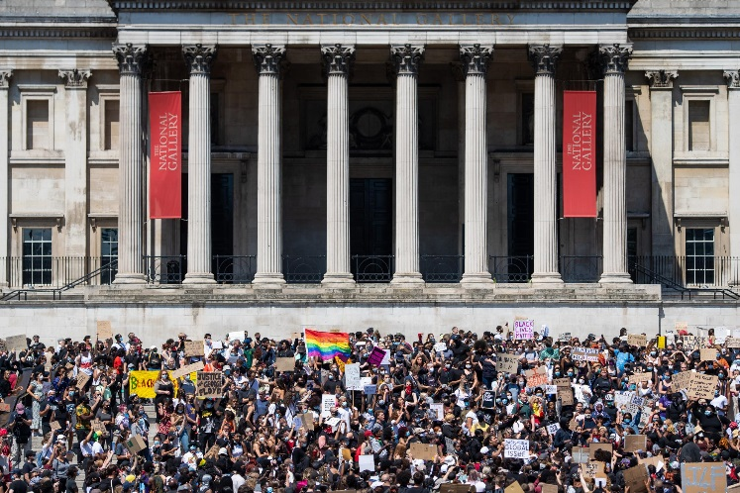
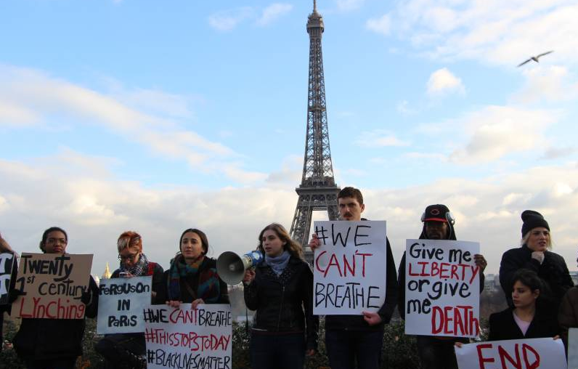
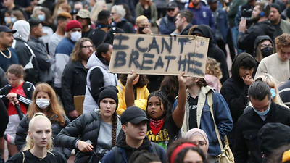
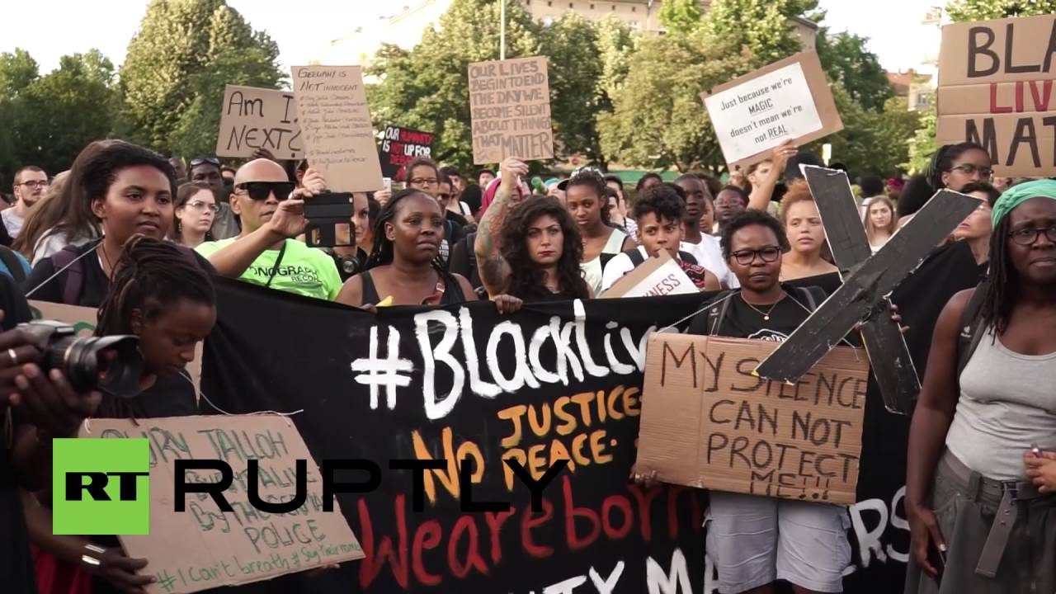
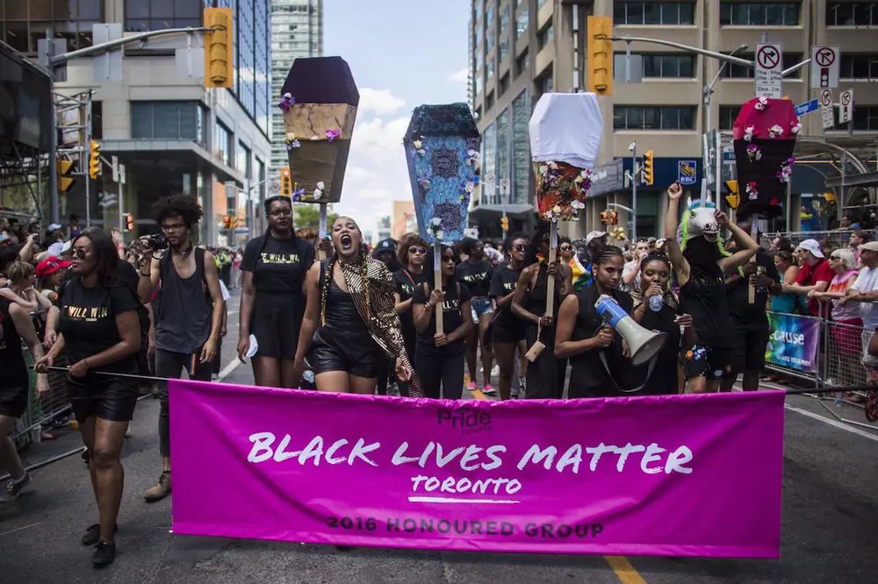
People across the world have shown support...
London – England
Minneapolis - America
Paris – France
Auckland – New Zealand
Berlin - Germany
Toronto - Canada

Slide 22
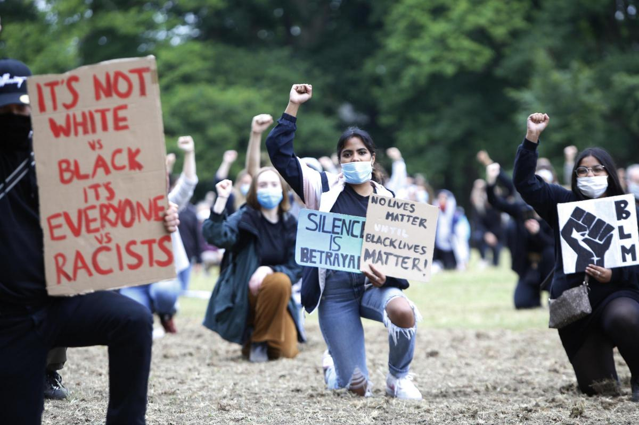
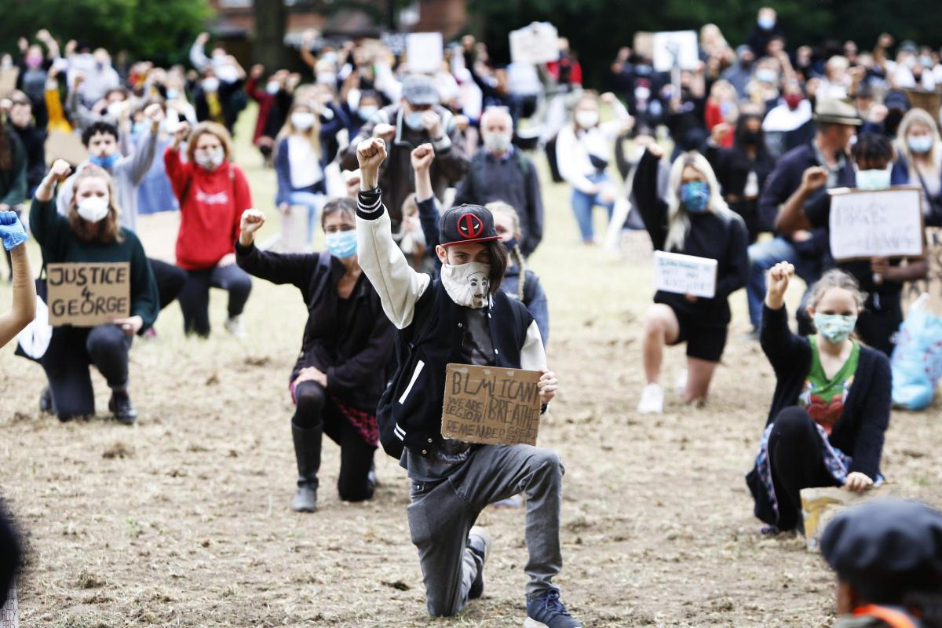
A few days ago a Black Lives Matters protest was in Oxford, here people also showed responsibility by wearing masks and making sure they stayed socially distanced.

Slide 23
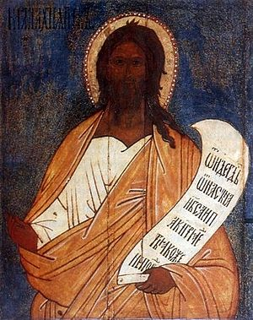
Malachi 2:10
Have we not all one Father? Has not one God created us? Why then are we faithless to one another?

Slide 24
Dear God,
Be with us in our homes today
In our work and in our play
Be in our hearts and in our minds
In all we do and say
Teach us how to grow in love
Each and every day
Amen

Slide 25
Who or what will you stand up for this week?

Slide 26
https://www.youtube.com/watch?v=YGpJb_Q7YkA
Sing

