Slide 1


Assembly 20th April
Prepare yourself and prepare your space.

Slide 2

Our values for this term:
Responsibility
Co-operation
Friendship
We are really hoping to be back together to practise the third one in term 6!

Slide 3
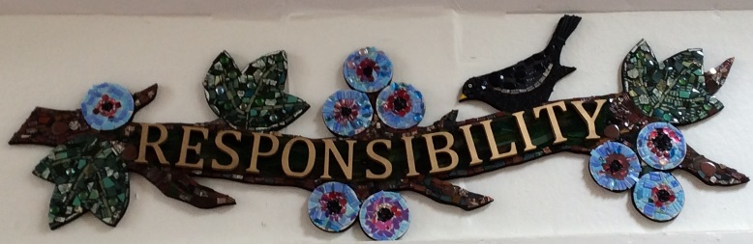
Responsibility
This is a really important one for us because it is also one of our core values.

Slide 4
Let’s think about our responsibilities…........
I have to make sure all of you are happy and that you are learning as well as you can.
I have to make sure all the staff who work in school are happy and have everything they need to do their job well.
I have to make sure our school is safe.

Slide 5
Teachers
They have to make sure that you learn the right things and that your learning is interesting.
They have to make sure you are all working hard, learning new things and remembering what you have learnt.
They have to help you with your well being and support you when you have problems

Slide 6
What are your responsibilities?
To try hard
Not to give up
To put effort in
To be curious
To ask questions
To help each other
To be independent

Slide 7
Remember, Mum and Dad have responsibilities too.
They have to get their work done to a high standard – other people will be relying on them to do their bit.
They can also help you – when you need it (but sometimes you might be able to help yourself!)

Slide 8
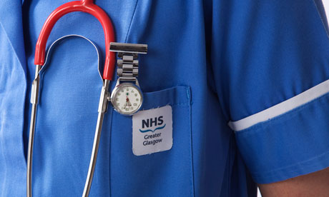
Corona Virus
Corona Virus
NHS staff have to be very brave to accept their responsibilities. They have to look after people who are ill, knowing that they might get ill too.
Sometimes responsibility needs us to have courage.
Can you think of someone in the Bible who was courageous?

Slide 9
The Good Samaritan!
The Good Samaritan knew that he must stop and help the person who was injured even though he was probably worried that he might get beaten up and robbed too. It was his responsibility to help his neighbour – his fellow man.

Slide 10
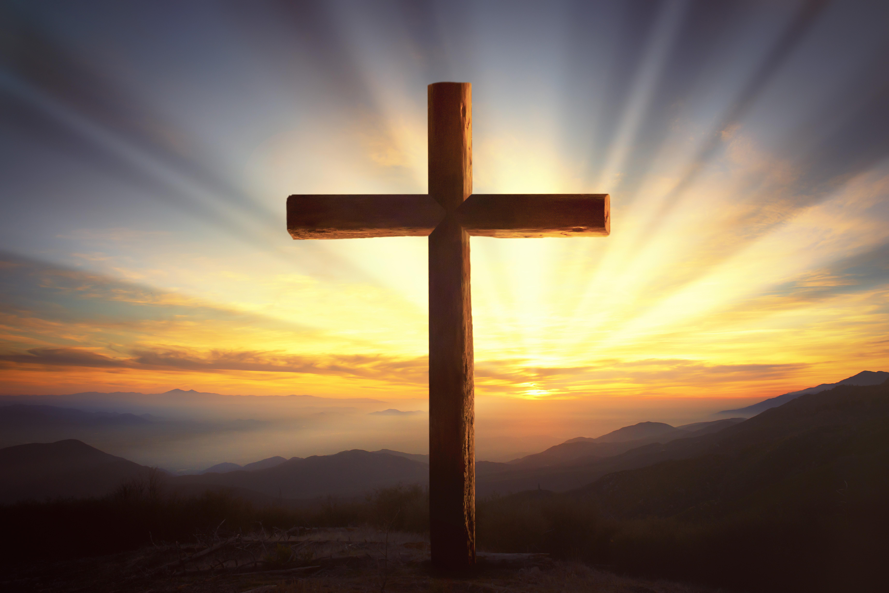
There are lots of other examples and Jesus was brave every day - particularly at Easter time when he had to follow God’s plan to help show people how important God was.

Slide 11
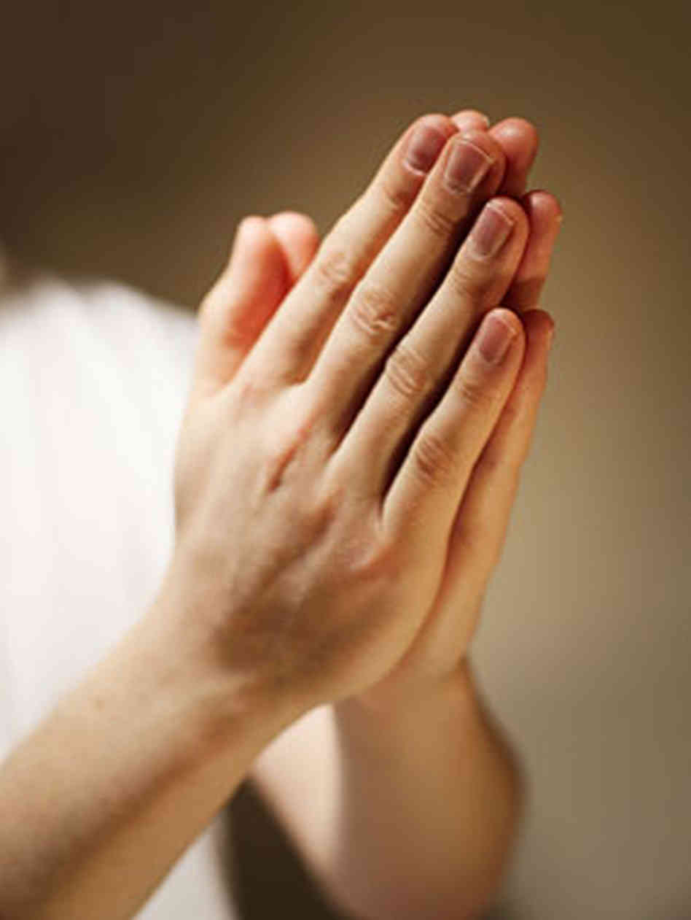
Our school prayer
Dear God,
Be with us in our homes today
In our work and in our play.
Be in our hearts, be in our minds
In all we do and say.
Teach us how to grow in love
Each and every day.
Amen

Slide 12
How will you be more responsible this week?
Will you get dressed quicker?
Make your own breakfast?
Find your work on Class Pages and get started by yourself?
Find a solution and be brave to do something your own way?
Find something to do if Mum and Dad are busy?
Eat all you tea?
Help tidy up?
Make your bed?
Help your brother or sister?

Slide 13
Remember it doesn’t matter that we are not together in school, we are together in our thoughts. Ruth’s Song reminds us of this. You can just listen or join in if you wish.
https://uk.video.search.yahoo.com/yhs/search?fr=yhs-domaindev-st_emea&hsimp=yhs-st_emea&hspart=domaindev&p=wherever+you+may+go+I%27ll+be+always+ast+your+side+wherever+you+go+you%27ll+find+me+there+for+your+god+is+mine#id=6&vid=3a21871efacd5107f6a2e8e67d2a8c56&action=view

